Slide 1
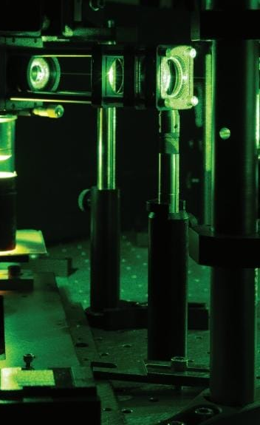
Mini-symposium
Versatility in Raman Spectroscopy
(on the occasion of the PhD defense of Bram Mooij)
9 December 2025
10:00 -11:45 h (arrival and coffee 9:45)
VO Building, room Spectrum 5 (2nd floor)
De Boelelaan 1100; Amsterdam
PROGRAM
10:00 Dr. Sara Mosca; Rutherford Appleton Laboratory, UK
Spatially Offset Raman Spectroscopy (SORS) – Non-Invasive Chemical Analysis by Light: An Overview on Biomedical and Cultural Heritage Applications
BREAK
11:00 Prof. Dr. Hervé Rigneault, Institut Fresnel CNRS Aix-Marseille Université, France
Super-resolved wide field multiphoton imaging using speckle light
13:45 PhD defense Bram Mooij
Auditorium; VU Main Building
You are all welcome to attend!
Freek Ariese (VU LaserLaB)
and Gareth R. Davies (VU Earth Sciences)

