Slide 1
WP1 meeting
Romania campaign preparation
25 Feb 2026

Slide 2
Agenda
Site selection
Aircraft
remote sensing
In situ
EM27
Drones and Vehicles
In situ isotope analysis EMPA
SENSIRION stationary sensors?
Pre-campaigns INCAS team
Meteorological forecasting
Participation IMEO scientists
Data storage and templates

Slide 3
Site selection, Swiss aircraft/AVIRIS-4
O&G: Flight lines similar to ROMEO 2021 with “all” production clusters
Landfills, including VIDRA landfill (ideally multiple times)
Coal mines, open and underground – low priority
Mud volcanoes - low priority
Include Transylvania
Attempt a flight over Black Sea production sites already in 2026? - NO
Do we need prior GHGsat data for planning? – not needed

Slide 4
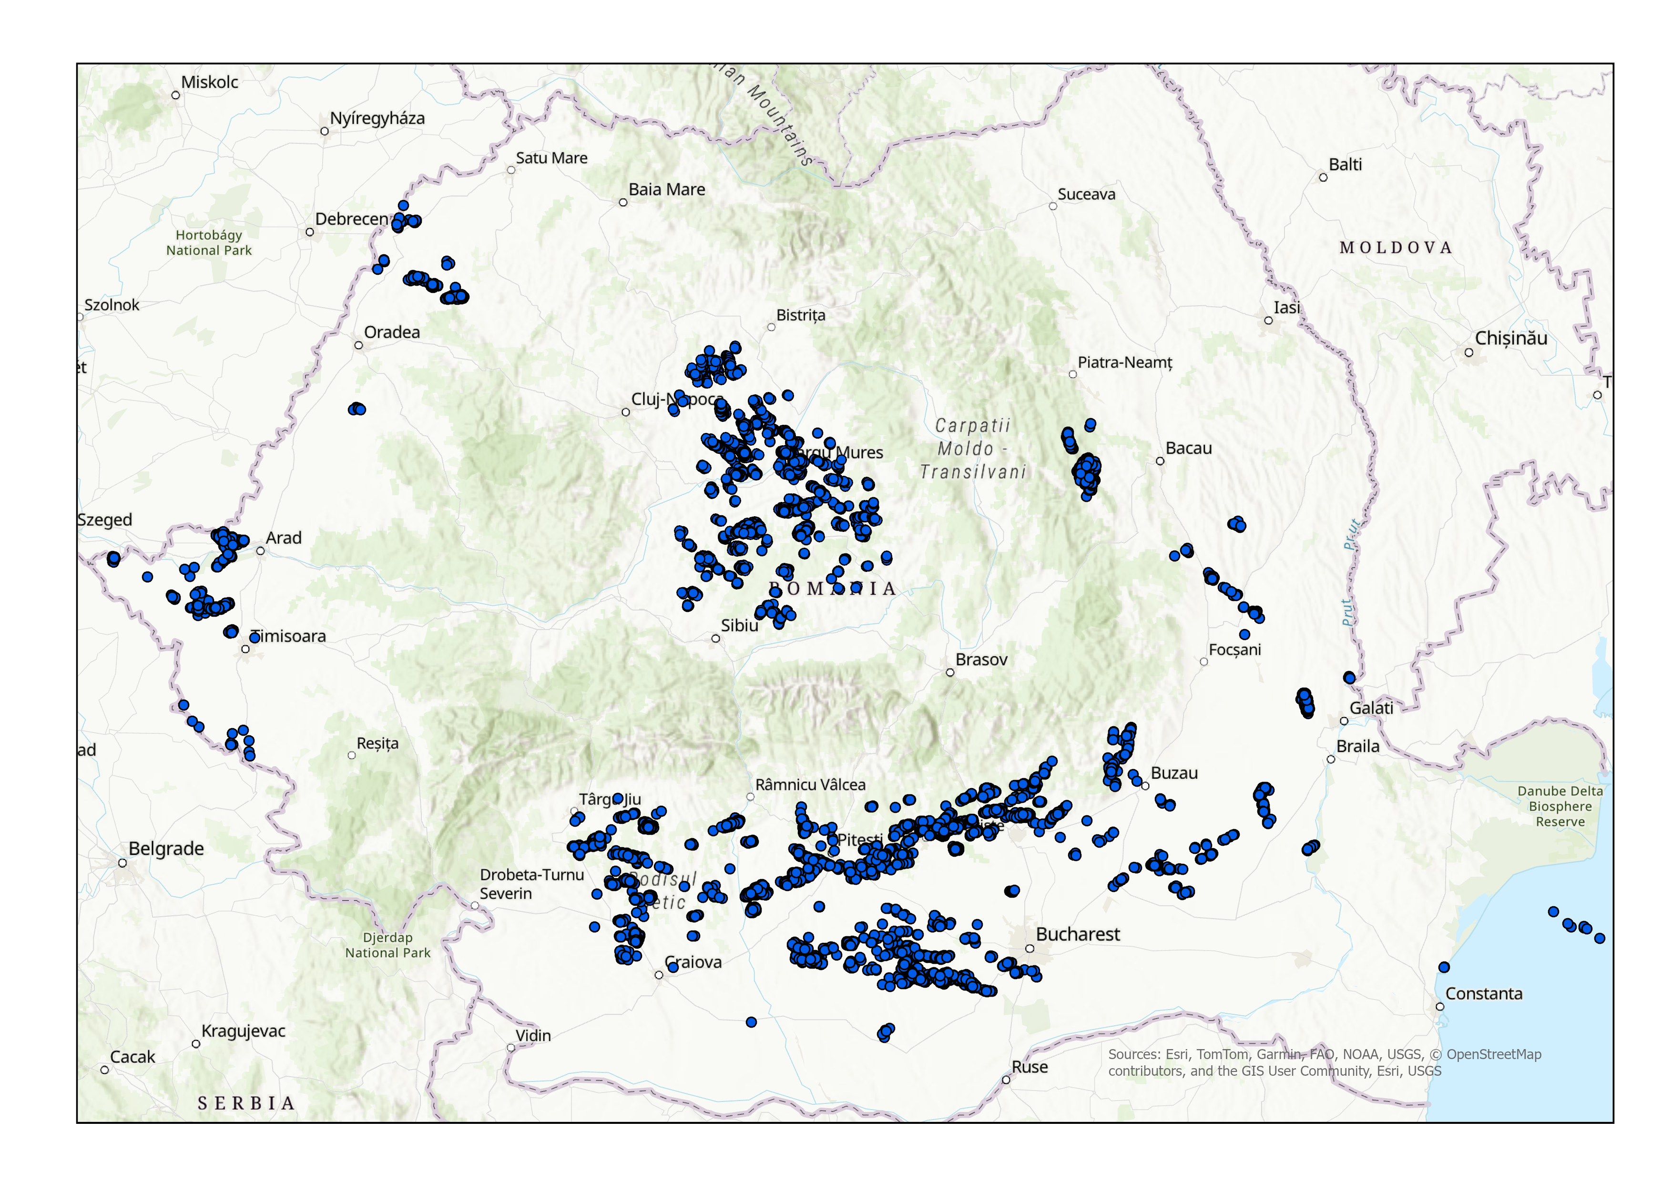
O&G: Individual sites available for ROMEO
Do not share

Slide 5
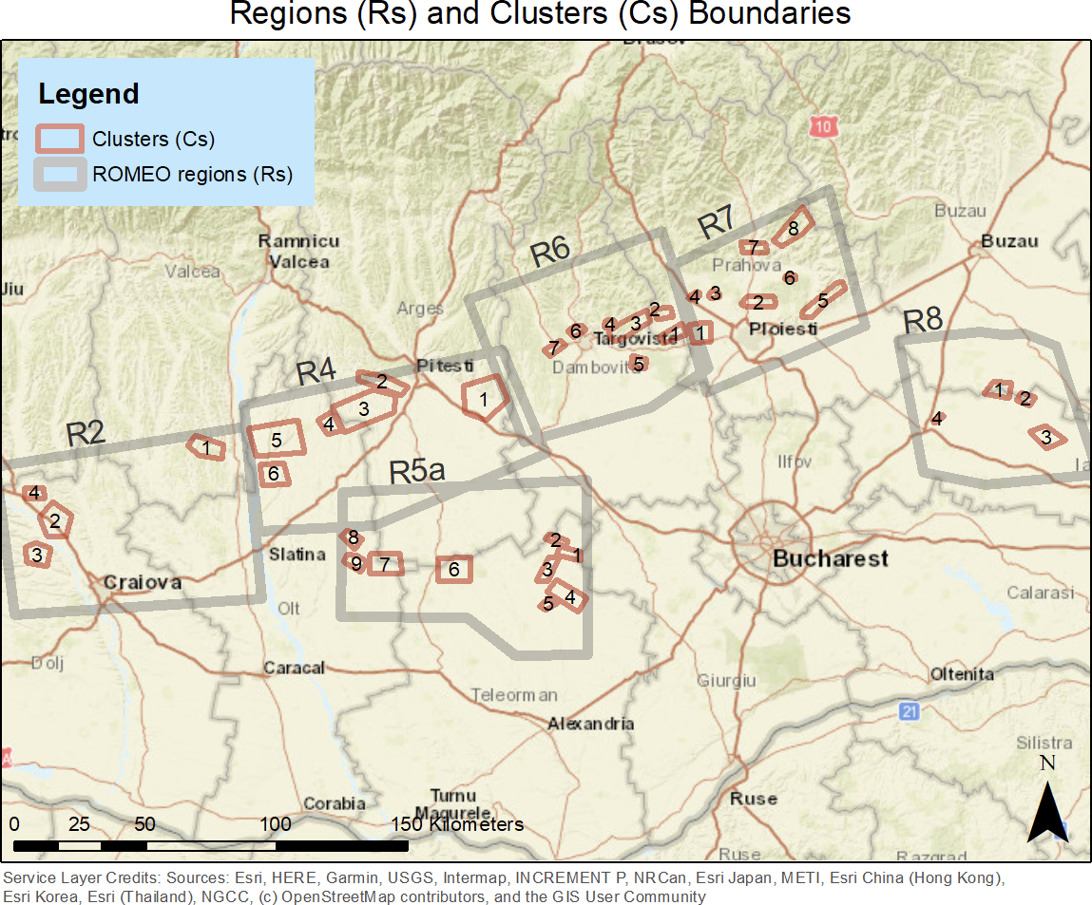
O&G: ROMEO target regions and “clusters”
Do not share

Slide 6
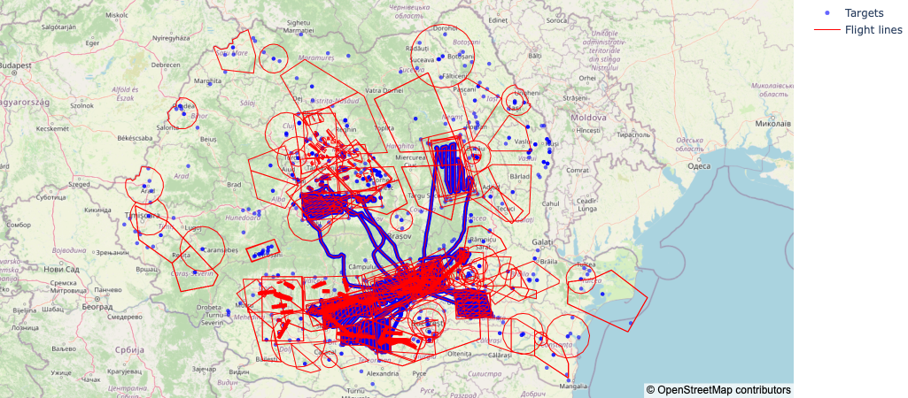
Waste
Do not share

Slide 7
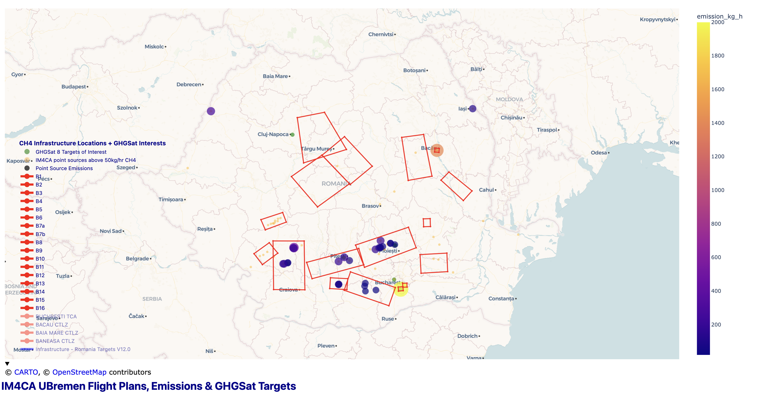
Landfills Romania
Do not share
EMPA Romania Landfill Target List :
Vidra (Bucharest)
Glina (Bucharest)
Boldești-Scăeni/Prahova
Pitești
Any other landfill of interest for you?
INCAS Romania Landfill Target List :
UBremen Romania Landfill Target List :
GHGSat Romania Landfill Target List :
Vidra (Bucharest)
Rudeni (Bucharest)
Boldești-Scăeni/Prahova
Pitești
Cluj-Napoca
Notes:
Note: this map is an overall picture! It is not just for landfills.

Slide 8
Landfills Romania
Landfill Name | Reported/BU CH4 Emissions (2018) | Ground Measurement | GHGSat Info (2025) | Comments
Vidra (Bucharest) | 1280 t/yr |  | 2.2 t/hr | Also Carbon Mapper & EMIT quant. Available. Main active landfill for Bucharest. MBT on site, but flare/capture info limited;
Glina (Bucharest) | 1580 t/yr |  | Measured x 1 | No new waste, but leachate & odor. Potential hotspot.
Boldesti-Scaeni/Prahova | na |  | 171 kg/hr | 2x not measured by GHGSat. Subject to overcapacity disputes. Flare system status unclear. Methane plumes documented by Carbon Mapper.
Pitesti | na |  | na | 5 obs Carbon Mapper 2025 (177-334 kg/hr)
Rudeni (Bucharest) | na |  | 0.8 t/hr | 2022 GHGSat data. Permanently closed Nov 2023; AMM risk persists from capped cells; flare systems partly functional.
Brasov | 9620 t/yr
Cluj-Napoca | na |  | x5 Observed
Covasna | na |  |  | Compliant + cooperative (Eco Bihor) – small emissions likely
Bacau | 3310 t/yr |  |  | Carbon Mapper 2025: 1400 kg/hr
Do not share

Slide 9
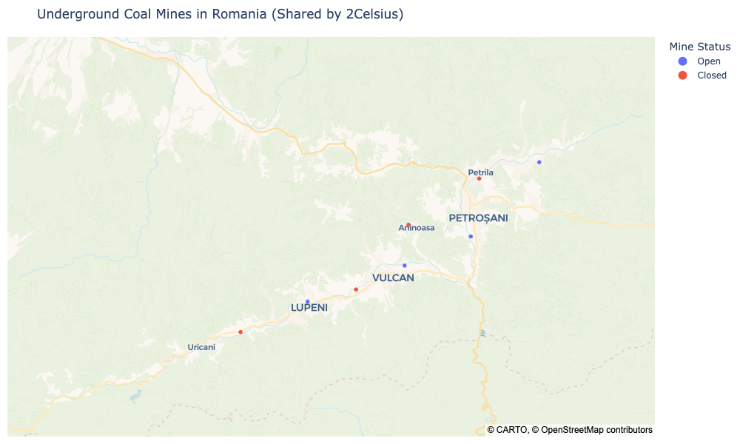
Coal
Underground coal mines in Petroșani
Coal Mine | Reported/BU CH4 Emissions (2018) | Comments (2Celsius Romania)
Lupeni | 795 t/yr | Open. Closure works by June 2026 (accelerated timeline cited by local/planning
Petrosani | 1360 t/yr | Open. Planned closure by Dec 2032
Petrila | 631 t/yr | Closed (2015). Historically very gassy—documented >15 m³ CH₄/tonne at faces; explosion case study exists. Ventilation Shaft No. 2 partially destroyed and deallocated during closure; legacy shafts, boreholes, and waste tips likely AMM points.
Vulcan (Jiu-Paroseni) | 2110 t/yr | Closed (2017). Mine closed; Paroșeni power station nearby remains an anchor site (FGD upgrades noted historically).
Vulcan (Vulcan) | 362 t/yr | Open; planned closure by Dec 2032
Uricani | 2370 t/yr | Closure completed with safety works (2018). Legacy galleries & flooded
Lonea (Petrila) | na | Open but in closure works; target Dec 2026
Aninoasa | na | Closed (2006). Likely minimal active ventilation.
Do not share
Notes:
Ball park: 72-270 kg/hr CH4 emissions

Slide 10
Site selection, Bremen Dimona aircraft/MAMAP & in situ
O&G: Selected production clusters
(ROMEO had defined ~ 40 clusters)
Waiting for NDA with Petrom
Can MAMAP measure on mountain terrain/forest (valley of methane) → measurement OK, but emission calculation difficult
Only smaller landfills possible, unless we get authorization
Coal mines, open and underground- low priority
Mud volcanoes – low priority
Get if possible prior GHGsat and pre-campaign data for planning, and pre-campaign visits of INCAS vehicle

Slide 11
Site selection, INCAS BN2 aircraft, in situ only
O&G: Selected production clusters
(ROMEO had defined ~ 40 clusters)
Waiting for NDA with Petrom
Ready for pre-campaign? → later
Do we have guidance from GHGsat sources?
Landfills: Can INCAS fly low around VIDRA landfill
→ possibly at 500 m altitude
Mud volcanoes? → not discussed

Slide 12
Site selection, EM27
Ideally VIDRA landfill site, but where to set up sensors?
Can we arrange private locations?
How many sensors?
Connect to EMPA in situ isotope observations?
Plan B: select other site, possible one of the GHGsat compressor stations

Slide 13
Site selection, in-situ isotopes EMPA
Ideally VIDRA landfill site, but where to set up sensors?
Can we arrange private locations?
Connect to EM27 observations?
Plan B: select other site with EM27, or separate
→ Can be hosted at INOE

Slide 14
Site selection, Vehicles & drones
Best for point sources, so O&G sites
Waiting for NDA with Petrom
Focus on sites in ROMEO clusters, but extend
Different categories:
Wells (gas/oil)
Oil parks
Compressor stations
Obtain RANDOM sample set, no high emitter bias
Include smaller landfills?
Tracer release (N₂O (UU), Acetylene (LSCE))??

Slide 15
Site selection, Stationary sensors
Is Sensirion still interested/ready to install sensors?
One compressor station?
One oil park?
Waiting for NDA with Petrom
Downwind from landfill (with EM27)?
Can we install a Picarro from INCAS/INOE (with EM27)?

Slide 16
Site selection, Pre-campaign INCAS
Which GHGsat observations do we have?
Goals:
Pre-campaign flights
Test INCAS in-flight setup (including wind)
Independent estimate of emission magnitude
Pre-campaign vehicle surveys
Identify GHGsat emitters
“Valley of methane” N of Ploiesti
City/landfill surveys?

Slide 17
Agenda
Site selection
Aircraft
remote sensing
In situ
EM27
Drones and Vehicles
In situ isotope analysis EMPA
SENSIRION stationary sensors?
Pre-campaigns INCAS team
Meteorological forecasting
Participation IMEO scientists
Data storage and templates
Other points???

