Slide 1
A 360 DEGREES PERSPECTIVE ON THE VALUE OF MUSIC
Music360 Review 2
Date: 20 April 2026

Slide 2
Agenda
9.30 – 9.35 Welcome, Tour de table, Jaap Gordijn(VU)
9.35 – 9.55 Work package 1 - Conceptualization and measurement of monetary and non-monetary value of music, Ingmar Leijen (VU), María de Miguel Molina (UPV)
9.55 – 10.15 Work package 2 - Standardized, trusted and unified collection of music metadata, Giovanni Giachetti (UPV), Oscar Pastor (UPV), Jaap Gordijn(VUA)
10.15 – 10.35 Work package 3 - Stakeholder-level reporting and analysis of the value of music, Gonçal Calvo (BMAT)
10.35 – 10.55 Work package 4 - Ecosystem-level reporting and analysis of music value creation, distribution and consumption, Roel Wieringa, (TVE)

Slide 3
Agenda – cont’d
10.55 – 11.10 Coffee break
11.10 – 11.30 Work package 5 - Sustainable business model of Music360 solution, Bruno Gaminha (GDA)
11:30 – 12.10 Work package 6 - Living labs, Lisa Ni Choisdealbha (IMRO), Piia Moore (GTM)
12:10 – 12.30 Work package 7 - Dissemination, communication and exploitation
12.30 – 12.40 Work package 8 - Project management and data management, Lima Kohestani (VU)
12.40 – 12.45 Work package 9 – Ethics, María de Miguel Molina (UPV)

Slide 4
Agenda – cont’d
12.45 – 13.15 Internal PO/reviewers meeting
13.15 – 13.45 Feedback and conclusion

Slide 5
Work package 1 - Conceptualization and measurement of monetary and non-monetary value of music
Ingmar Leijen (VU), María de Miguel Molina (UPV)

Slide 6
Music360 WP1: Theoretical foundation
Questions | Tasks | Results | Outcome
Q1.1 Aspects / components of the value of music | T1.1a/b Modelling the value of music | R2: Design of Conceptual model of the value of music | D1.1: A framework to quantify and qualify the value of music, version 1 D1.2: A framework to quantify and qualify the value of music, version 2
Q1.3 Aspects of the value of music relate to each other, and consequences for measurement
Q1.2 Methods and data needed to measure the various aspects of the value of music | T1.2a/b Measuring value of music | R3: Design of value measurement methods
Q1.4 Reasoning about the value of music, given the collected data | T1.3a/b Analysing value of music | R4: Design of value analysis methods
Notes:
Welcome to my presentation of the first workpackage of the Music 360 project. This work package builds the theoretical foundation for measuring the value of music in Music360. And to give a bit of an overview of this workpackage we included a table that gives an overview of the different aspects of the project. We started with a set of questions: what are the different components of music we should take into account, how these components interact and relate, what methods and data do we need to be able to say something meaningful about the value of music. These questions were leading to different tasks to answer the questions, after which we described the different results, that finally lead to a framework for quantifying and qualifying the value of music.

Slide 7
Why do we need a framework for the value of music?
1. Multiple types of value:
Economic, cultural, social, emotional/therapeutic
These values coexist and interact
2. Fragmented Research:
Different definitions, stakeholders, contexts, and methods
No shared structure across studies or applications
3. Need for comparability:
Across stakeholders (users, artists, venues, cities)
Across contexts (background vs foreground, indoor vs outdoor)
Notes:
To start with the question why we would need a framework: Music has many values (economic, social, cultural, therapeutic), but the knowledge about these values is fragmented in literature: there is quite some stuff on economic outcomes of background music, there is some literature on the therapeutic value of music, in the area of music therapy: how music can be used distract from treatments, etcetera. There is also literature on the way music is creating value in a cultural sense, and music in the context of social relations: how people bond with other people over music, what music means to people, how they enjoy music and so on and on. So, the value of music is multidimensional, but existing approaches only quantify the economic value, and the relation between economic and non-economic values is not really investigated: there are many different areas of research, but they are rather unconnected.
So, this first work package addresses the need for a comprehensive, theory‑based approach that includes cultural, social, emotional/therapeutic, and economic values, and makes them measurable.

Slide 8
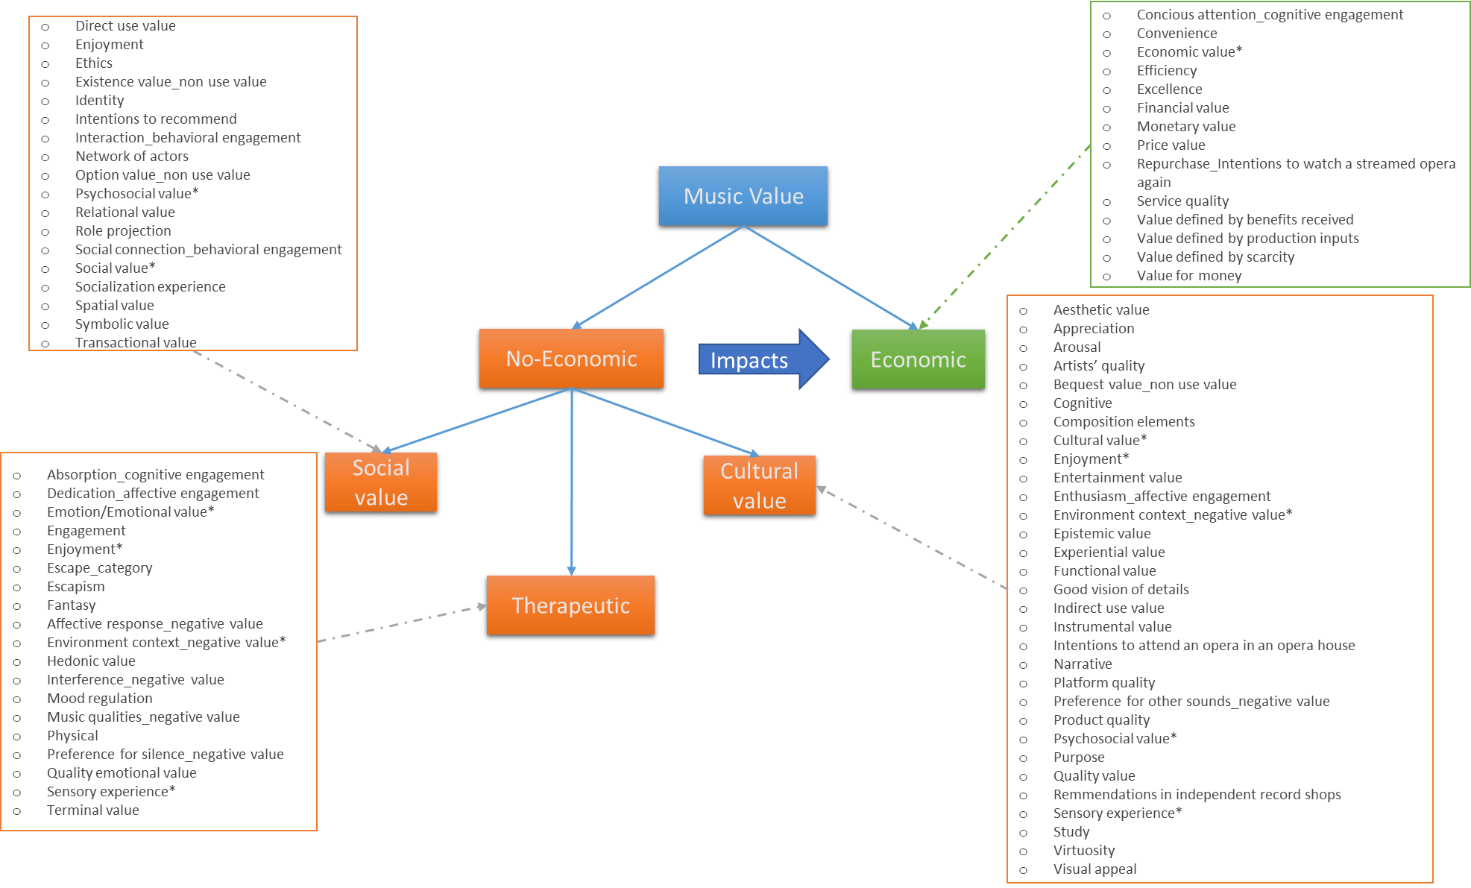
Notes:
This model is the foundation for making all these value dimensions measurable in the digital platform. It starts from the general container of music value, and divides into economic value in green and non-economic values of cultural, social and therapeutic values in orange. These value categories are in themselves again representative for many more subcategories of value. The different list of values and subvalues were taken from the extensive literature search that is the first part of this workpackage. Of course this list is on the one hand not complete and on the other hand too extensive to investigate, but it gives an indication of the content of each of these value categories.

Slide 9
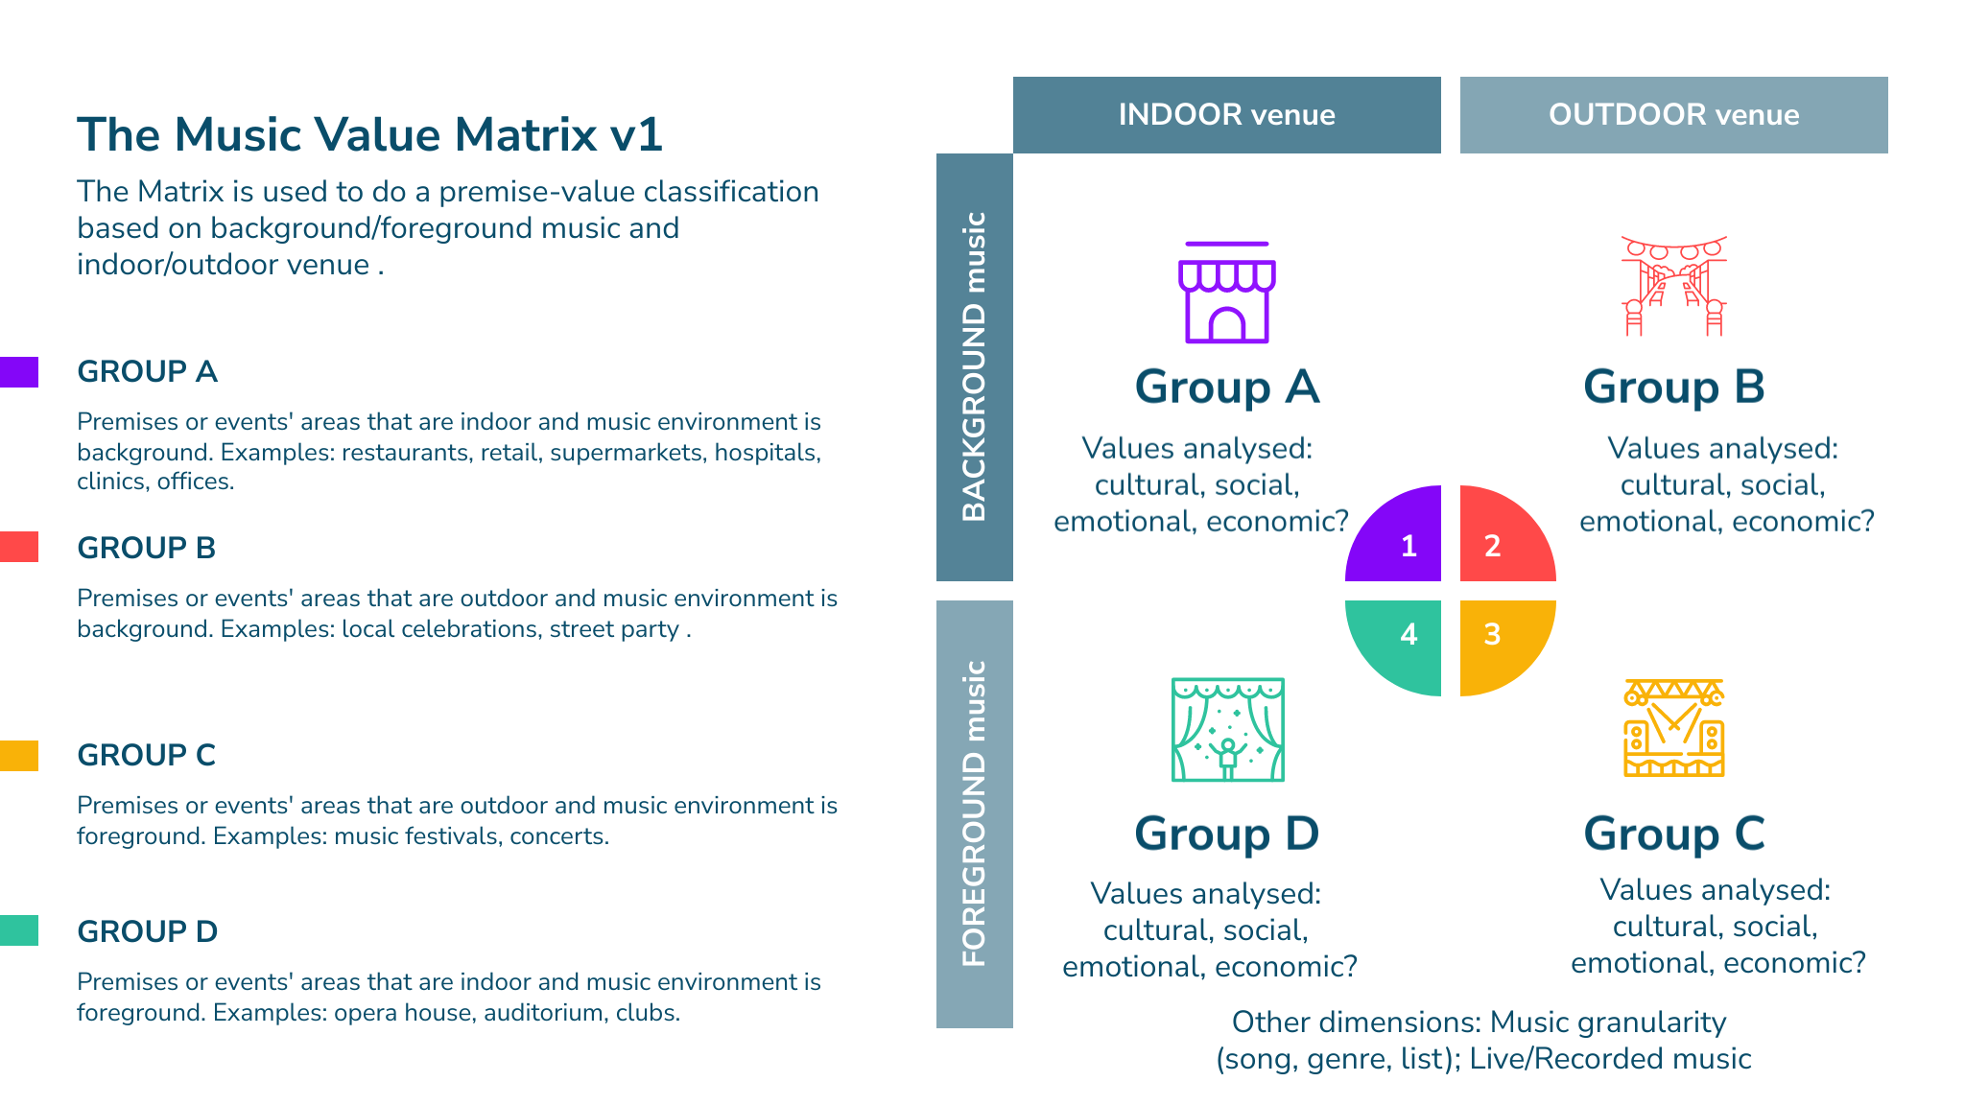
Context of Music Creation
Notes:
So our conceptual model shows the way music is creating economic and non-economic values. Our next step is to see how we can investigate value creation accross different contexts. For this we developed a matrix based on where the music is played, were we made the distinction between indoor and outdoor venues on the horizontal axis. And the other distinction that we made was between foreground and background use of music. Within each of these quadrants we identified what kind of value creation might be most salient.

Slide 10
Living Lab Design: value measurement and analysis
Quantitative
Data
(Statistical analysis)
Qualitative
Data
(content/thematic analysis)
Which
stakeholders,
venue, and
values
to analyse?
Which data to collect using:
Interviews
Surveys
Experiments (field experiments)
Existing data
Surveys
Field experiments
In depth Interviews
existing data
Notes:
Combining the matrix with the conceptual model we thought about different ways of collecting data to measure the ways music creates value. The idea was that we would measure the different forms of value creation, as well as cover each of the quadrants, indoor outdoor and background-foreground music. Depending on these different contexts, this gave us directions which value do we want to measure, which stakeholders do we want to investigate, and which venues can we ask to collaborate in the Living Labs.
Based on these considerations we developed different data collection methods, both qualitative as well as quantitative. For more in depth exploration of how music is perceived and used in service-settings we proposed to use interviews. To measure how music created cultural and emotional values indoors and outdoors we used a combination of qualitative and quantitative data-collection. Therapeutic value was also measured both quantitative and qualitative, with interviews and surveys. For the way music created value in a retail environment we relied on field experiments. The size of the experiments varied, from small scale interventions like the music therapy setting in Spain, to nation wide experiments like for instance in the Netherlands and Finland. Another way in which the value of music was measured was by using existing data from music venues.
To make this information accessible and meaningful we proposed different methods of analysis. For the interview data, which is qualitative, we proposed to use content and thematic analysis. For instance research in Ireland and Spain was based on interviews and thus a qualitative analysis. For the quantitatitve data we used different statistical methods. From descriptive univariate statistics like counts, means and correlations to more advances data science techniques in the field experiments and the enriched music playing data analysis

Slide 11
Data analysis proposed methods for the Living Labs
Interviews: data can be analysed with content analysis or thematic analysis and then communicate the results with a descriptive approach (frequencies).
Surveys: data can be analysed with a descriptive approach or with statistical and data science techniques
Field experiments: statistical analysis
Enriched music playing data: statistical analysis
Notes:
So we have all kinds of stakeholders in different contexts, and therefore used different ways of collecting data. To make this information accessible and meaningful we proposed different methods of analysis. For the interview data, which is qualitative, we proposed to use content and thematic analysis. For instance research in Ireland and Spain was based on interviews and thus a qualitative analysis. For the quantitatitve data we used different statistical analysis. From descriptive univariate statistics like counts, means and correlations to more advances data science techniques. The quantitative data was in the form of surveys with experimental conditions. Also one of the living labs used existing music performance data enriched with background data to show how music can create value in different venues.

Slide 12
WP 1 Main Conclusions
Music forms a complex ecosystem
  Stakeholders (artists, audiences, employees, venues, cities) value music differently.
  No single “dominant” value across all contexts → multi‑stakeholder approach needed.
Existing value theories don’t fully fit musical value
  Current classifications come from non‑music domains.
  Each value type (cultural, social, therapeutic, economic) contains many sub‑values → requires a refined, integrated framework.
Music value is multidimensional
  Living labs must capture this multi-dimensionality: different settings, different stakeholders
  Measurement tools must capture this multidimensionality: different data collections procedures, different analysis methods
Notes:
So, wrapping up the things we did for Workpackage 1: first we conducted an extensive literature review of how the value of music is currently measured in academic and applied research. From this analysis, three main conclusions emerged.
First, music operates within a complex ecosystem of interconnected stakeholders — artists, audiences, employees, venues, cities, and rights holders. But these stakeholders do not value music in the same way. For some, cultural value dominates; for others, social or economic value is more important. There is no single hierarchy of value. WP1 therefore emphasises the need for a multi‑stakeholder perspective.
Second, most existing value classifications come from theories designed for goods other than music. They provide many useful measurement items, but they do not match the specific characteristics of music. Moreover, every value category, whether cultural, social, emotional, therapeutic, or economic, is actually a bundle of multiple sub‑values. Measuring music therefore requires a more refined and integrated framework.
Third, Work package 1 shows that the value of music is multidimensional. Value depends not only on the type of value, but also on the context in which music is experienced — for example indoor versus outdoor, or background versus foreground. Listener experience and setting fundamentally shape how value emerges.
Overall, these conclusions show why WP1 needed to develop a new, integrated value framework: to make all value dimensions — especially non‑economic ones — measurable and ready to be incorporated into the digital platform. And next, based on this framework we elaborated on different research setups that could feed into the music360 ecosystem.

Slide 13
Work package 2 - Standardized, trusted and unified collection of music metadata
Giovanni Giachetti (UPV), Oscar Pastor (UPV), Jaap Gordijn (VUA)
Notes:
WP1 builds the theoretical foundation for measuring the value of music in Music360. The table gives an overview of the different aspects of the project. We started from a limited set of questions, leading to different tasks to answer the questions, after which we described the different results, that finally lead to a framework for quantifying and qualifying the value of music.

Slide 14
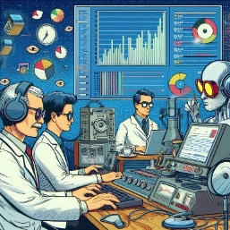



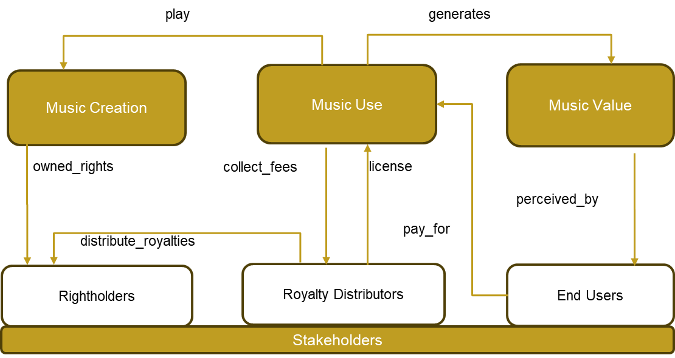








Work package 2 - Standardized, trusted and unified collection of music metadata (Overview)
Living Labs
Research Teams
Ontology and Metamodel
(v1/D2.1 – 31 Oct 2023; v2/D2.4 – 30 March 2025)
Formalize and standardize concepts related to the economic and non-economic value of music to facilitate data sharing
Architecture
(v1/D2.2 – 31 Dic 2023; v2/D2.5 – 30 May 2025)
Supports consolidation of distributed data between the various players in the Music360 ecosystem. Implements a DB model that aligns with the Music360 ontology.
Security
(v1/D2.3 – 29 Feb 2024; v2/D2.6 – 30 Jun 2025)
Rightholders
Mechanisms for maintaining data security and trust, supporting distributed information sources and the involvement of users in various roles, including CMOS, rights holders, music venues, living lab managers, etc.

Slide 15










Objective 2: Standardized, trusted and unified collection and representation of music metadata.
MDE to drive Data Interoperability and Technologies Development to characterize the music value chain
V1 & V2
V1
Front-ends, report generators, and data presentation tools
IoT devices for capturing real Music Use from recordings and live settings
reproduces
generates
Music Creation
Music Use
Music Value
V1 & V2
V1
Data exchange with research teams and empirical studies
(10+ Living Labs)
Tools for importing data from distributed and heterogeneous sources about Music Creation
owned_rights
collect_fees
license
perceived_by
distribute_royalties
pay_for
V2
V1
AI analytics tools (ML) for massive information and explainability
Rightholders
Royalty Distributors
End Users
Tools for importing data about royalty distribution (CMOs)
Stakeholders

Slide 16
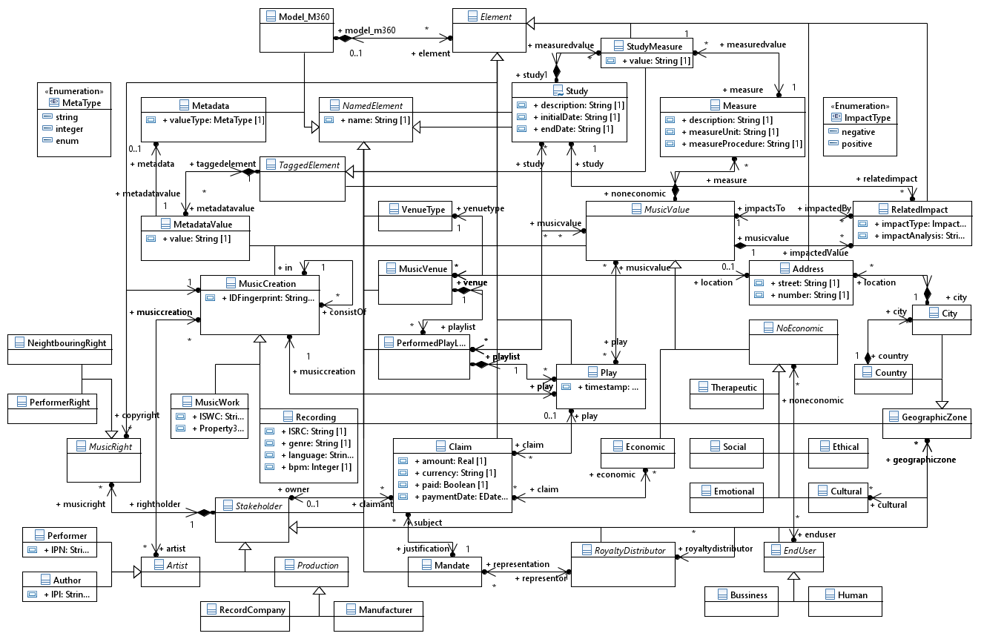
R5: Design of metadata ontology
Music 360 Ontology v2 in a Nutshell
https://doi.org/10.5281/zenodo.15063314

Slide 17
R5: Design of metadata ontology
Music 360 Ontology v2 in a Nutshell
Music Creation
https://doi.org/10.5281/zenodo.15063314

Slide 18
R5: Design of metadata ontology
Music 360 Ontology v2 in a Nutshell
Rights and Licence Management
https://doi.org/10.5281/zenodo.15063314

Slide 19
R5: Design of metadata ontology
Music 360 Ontology v2 in a Nutshell
Music Work and Recording Use
End users
https://doi.org/10.5281/zenodo.15063314

Slide 20
R5: Design of metadata ontology
Music 360 Ontology v2 in a Nutshell
Music Value
https://doi.org/10.5281/zenodo.15063314

Slide 21








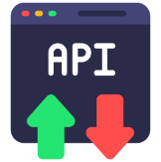




Music 360 architecture V2 – High Level Components
R6: Design of a Music360 platform for music data collection and representation
CMO + Monitoring (BMAT)
Music360 Backend
End-User
Data Visualization/
Analysis
Users
Data
Importer
Resource
server
Data Provider 1
Dashboard
Music360 private DB
Living Lab + Monitoring (BMAT)
Music360 API
Data
Importer
Resource
server
CMOs
Policy Makers
CMOx Members
Music Users
Research Teams
Data Provider 2
Music360 private DB
AI Tools
Research Environment
Data
Importer
Resource
server
Data Provider 3
LLM
Music360 private DB
Central DB

Slide 22




Music360 Architecture – Technologies
Fast response and startup
Great for horizontal scalability under a load balancer
Adequate for simple read-only APIs
Platform independent
API
+
Synchronizes logical models and database models
SQL transparent to the developer
Improved developer experience for debugging queries and model refinement
ORM
Run LLMs on local machines
Privacy. Data stays in the Music360 ecosystem.
Flexibility to change to any published LLM
Llama-3.2B
LLM
EuroLLM-9B

Slide 23
R7: Design of secure representation & access permission of confidential metadata
Developed a decentralized authentication structure, using the OAuth 2.0 / OpenID Connect standard.
Developed decentralized access control, using Row Level Security (RLS) policies at the database level. Policies are defined on the Music360 ontology.
These solutions allow data owners, such as CMOs, to keep in control of authenticating their own users, as well as enforcing who has access to which data.

Slide 24
OUT2: Application of homomorphic encryption
Demonstrator to show that parties, such as policy makers, can calculate the revenue of performers, for example with recordings of a specific genre.
Information to do the calculation, e.g., the revenue of individual performers, is not disclosed to anyone (privacy concern).
This is achieved with secure multi-party computing, specifically Prio+
Designed a solution to keep the relationship between IPI (authors) and IPN (performers), secret, while still being able to do queries, based on secret sharing technology.
Developed an approach to select and design a secure multi-party computing solution, consisting of existing technologies, given a set of security requirements.

Slide 25




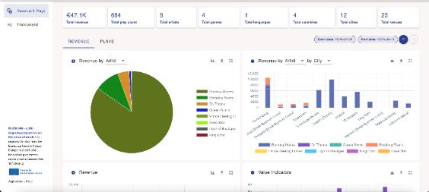




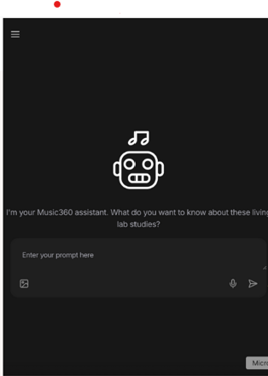

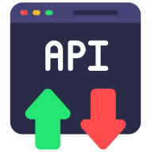


OUT4: Better data quality
1. Run Living Labs
3. Analyze
AI bot to compare the selected studies and get deeper insights.
Classic music impacted positively on patients’ recovery in living labs studies
2. Generate and
import
Living Labs reports
(playlists, context, metadata, measurements, analysis (unstructured text), etc.)
Answer
CREATE Playlist ...
CREATE Music Value ...
CREATE Related Impact .,.
CREATE Study ...
Importer API
Studies
Quantitative data
Music360 Private Database
Resource Server

Slide 26
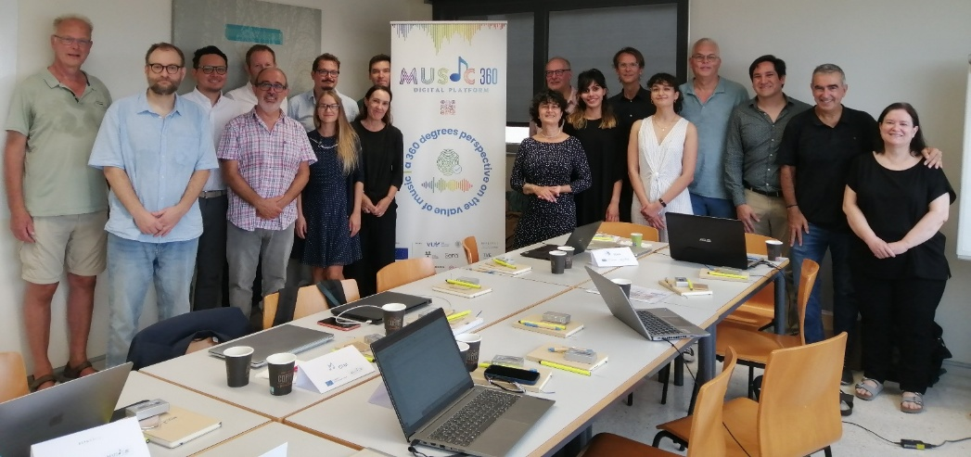
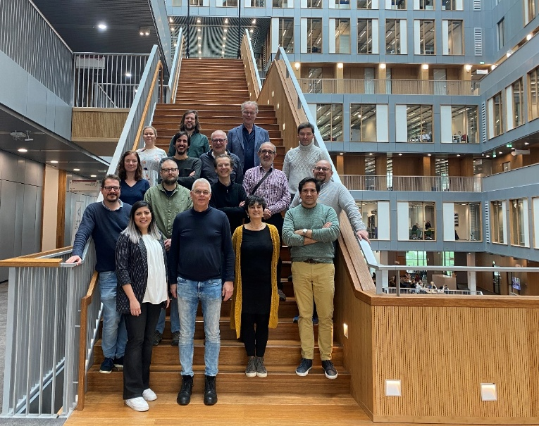
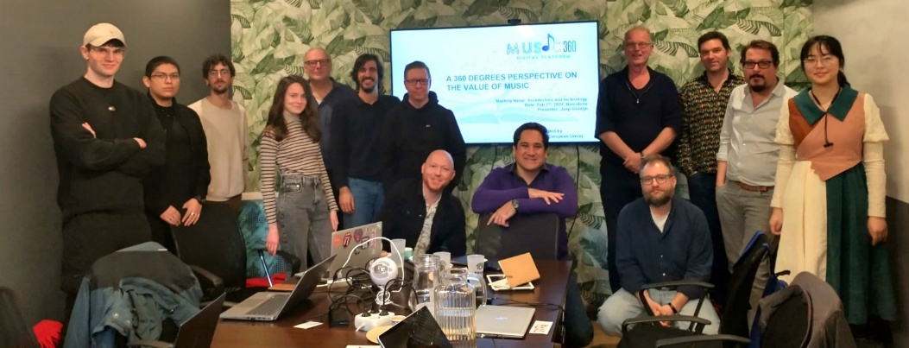
Conclusions
Deliverables have been developed through collaborative activities in an iterative process with the stakeholders of the Music360 project.
The developed ontology, architecture and security mechanisms meet the requirements of the different stakeholders involved in the project. Validated during the consortium meetings (Final validation in Helsinki 2025)
The architecture implementation (Music360 Platform) has been continuously validated and improved by means its application in the Music360 Living Labs.

Slide 27
Work package 3 - Stakeholder-level reporting and analysis of the value of music
Gonçal Calvo (BMAT)
Notes:
WP1 builds the theoretical foundation for measuring the value of music in Music360. The table gives an overview of the different aspects of the project. We started from a limited set of questions, leading to different tasks to answer the questions, after which we described the different results, that finally lead to a framework for quantifying and qualifying the value of music.

Slide 28
Objective 3: Stakeholder-level reporting and analysis of the value of music
Q3.1: How to support the presentation and analysis of the value of music with software tools
Q3.2: How to restrict information concerning the value of music per stakeholder?
R8: Design of a Music360 platform for stakeholder value analysis and reporting
T3.1a/b Designing an implementing stakeholder data presentation tools
T3.2a/b Music360 platform value analysis and reporting tools
Related Work Packages:
WP2: WP3 is the primary consumer of the "Music360 Data Platform" developed in WP2
WP6: Data source for the dashboard; WP3 is the foundation of the OpenAPI Access

Slide 29
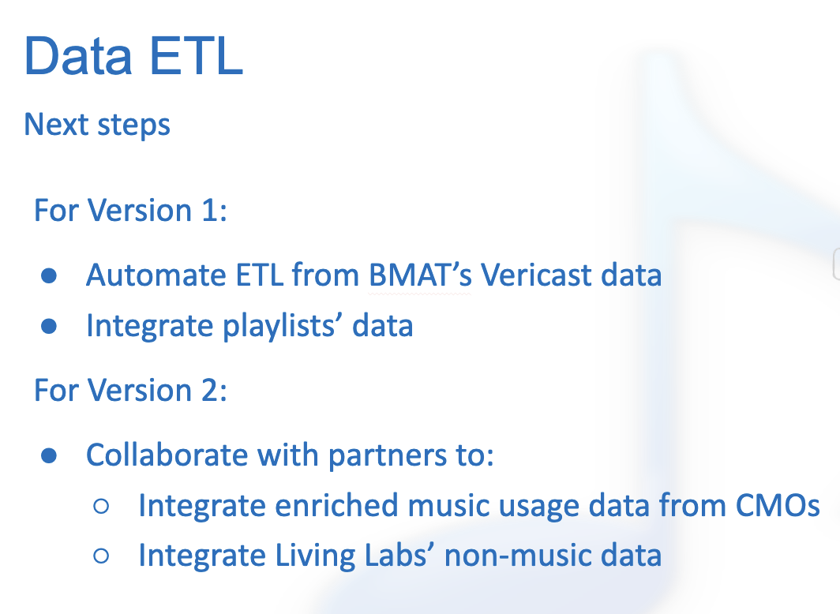
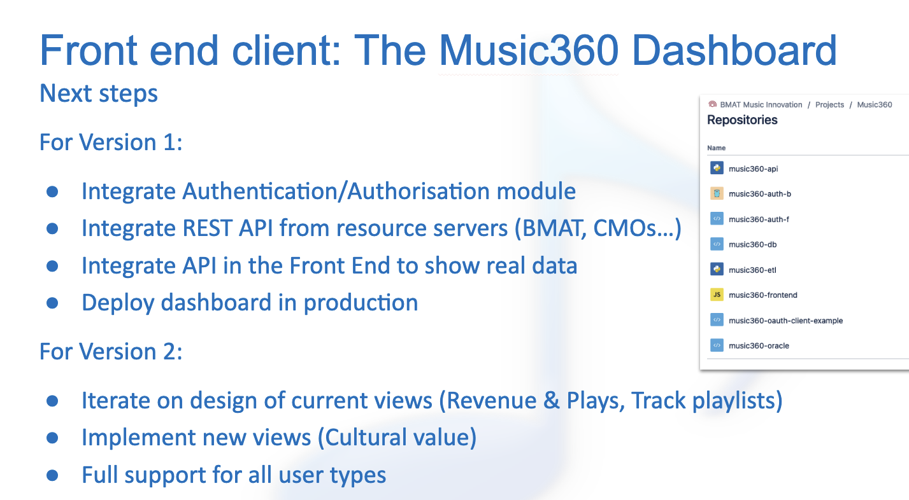
The WP3 Journey: Delivering the Mandate
From wireframes to a full-fledged dashboard: In RP1 we presented the wireframes, user stories and a staging demo with mock data. And promised:

Slide 30
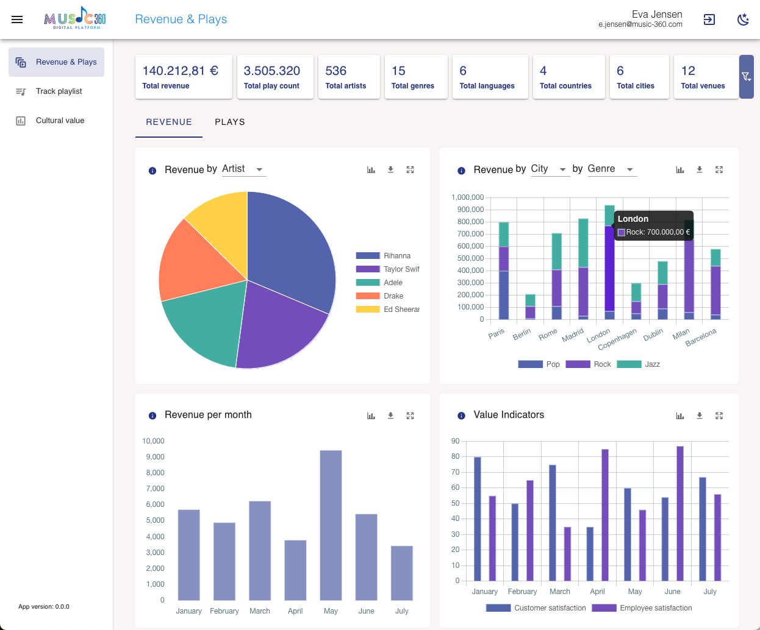

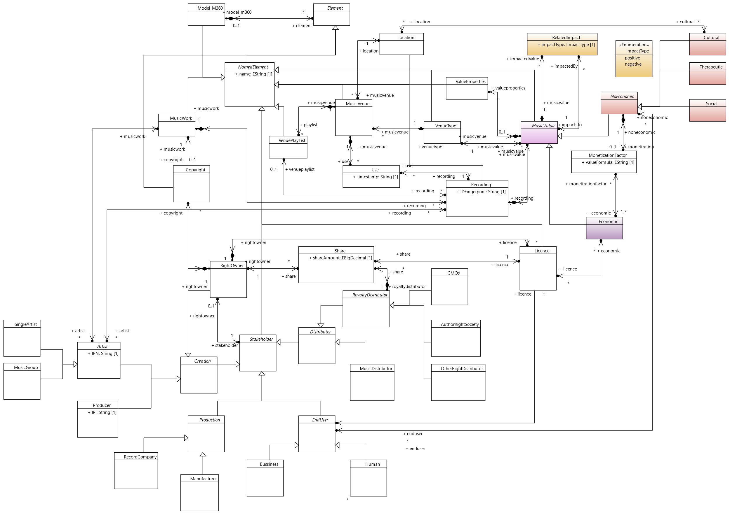


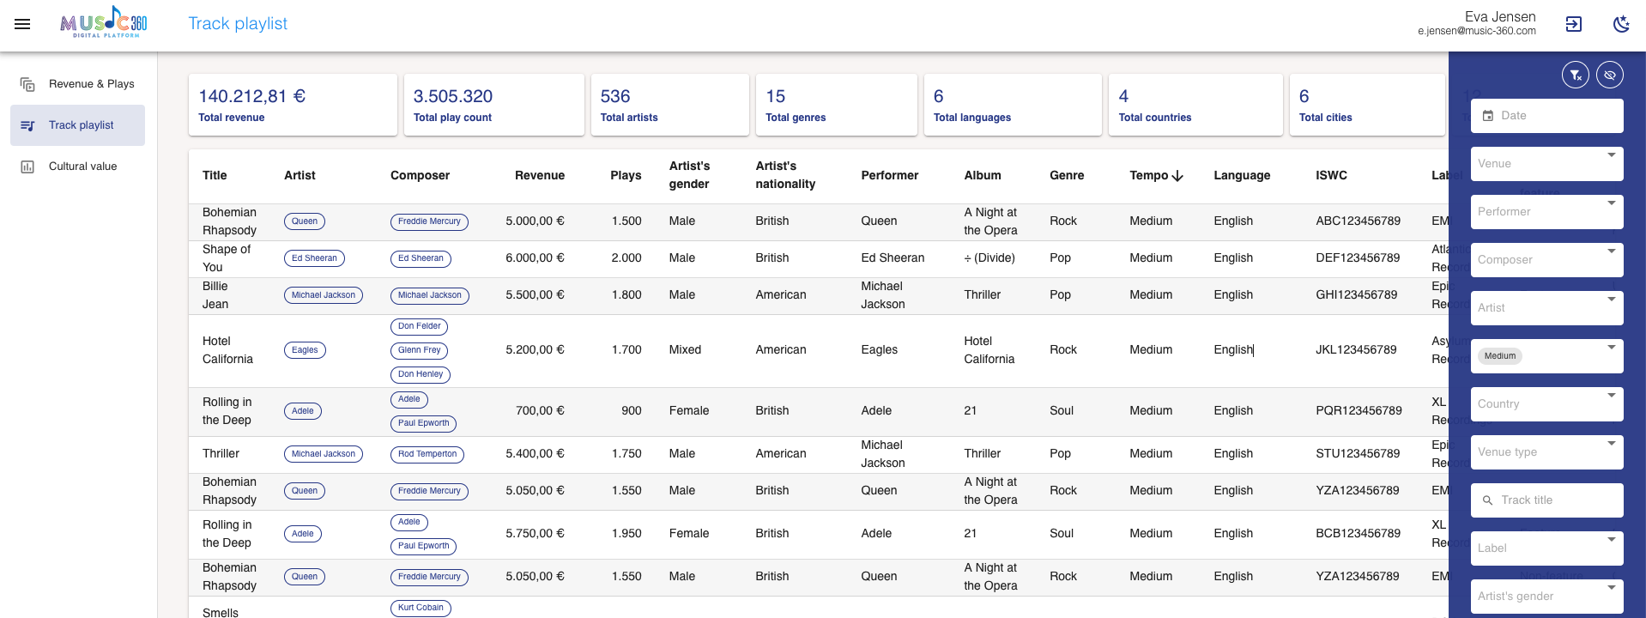




The WP3 Journey: Delivering the Mandate
D3.1 (Dashboard v1): Integrated Authentication (JWT), connected the REST APIs, and deployed the production environment with real venue data.
D3.2 (Dashboard v2): Finalized the UI, integrated qualitative "Cultural Value" studies, implemented strict Role-Based Access Control (RBAC), and deployed the AI Agent.
Living Labs
Music Use/Metadata

Slide 31
Serving All Stakeholders Securely
The Core Challenge: How do we serve creators, venues, and researchers on the same platform without violating commercial privacy or GDPR?
The Solution: Strict Role-Based Access Control (RBAC).
Role-Based Access Control (RBAC) Matrix:
  Creators / CMOs: Access to granular revenue and plays only for their authorized IPI/IPN assets.
  Venue Owners: Restricted specifically to the logs of their own premises.
  Researchers / Public: Access to global, aggregated trends (individual revenues/assets are dynamically masked).

Slide 32
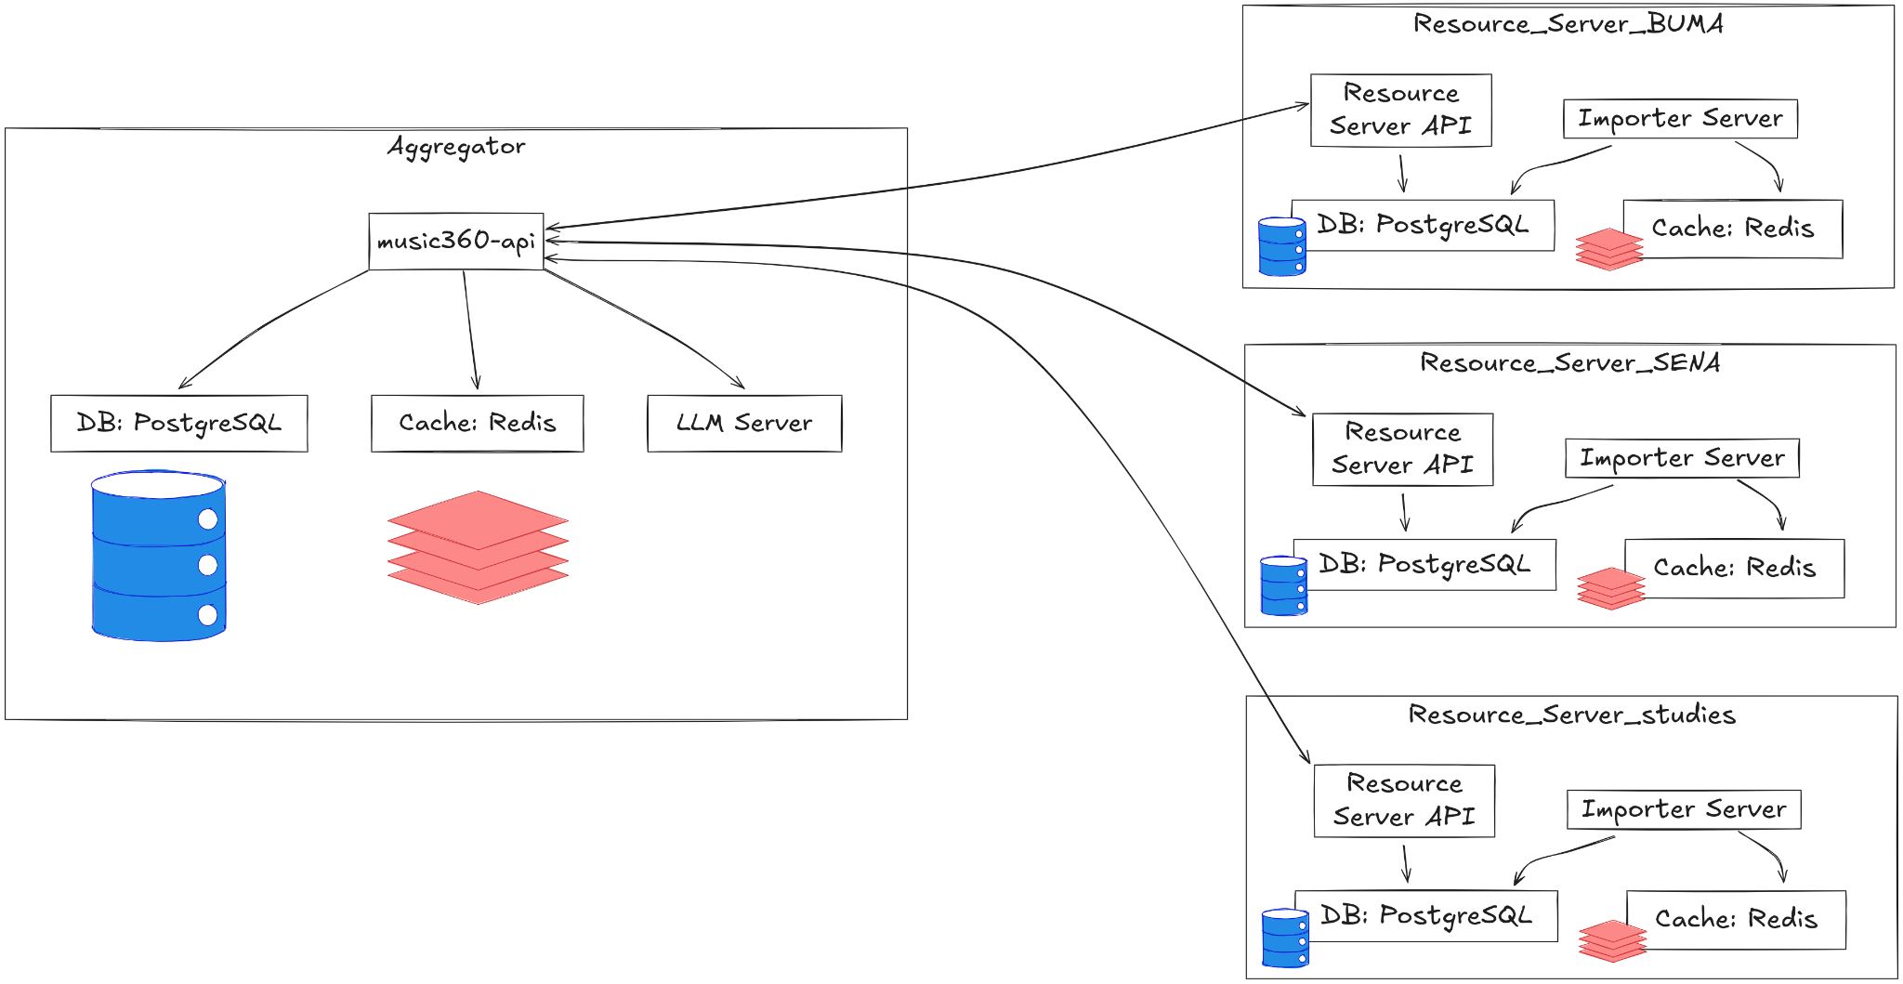
A Modern Decentralized Architecture
A single interface providing aggregated data from multiple independent resource servers within the Music360 ecosystem.

Slide 33
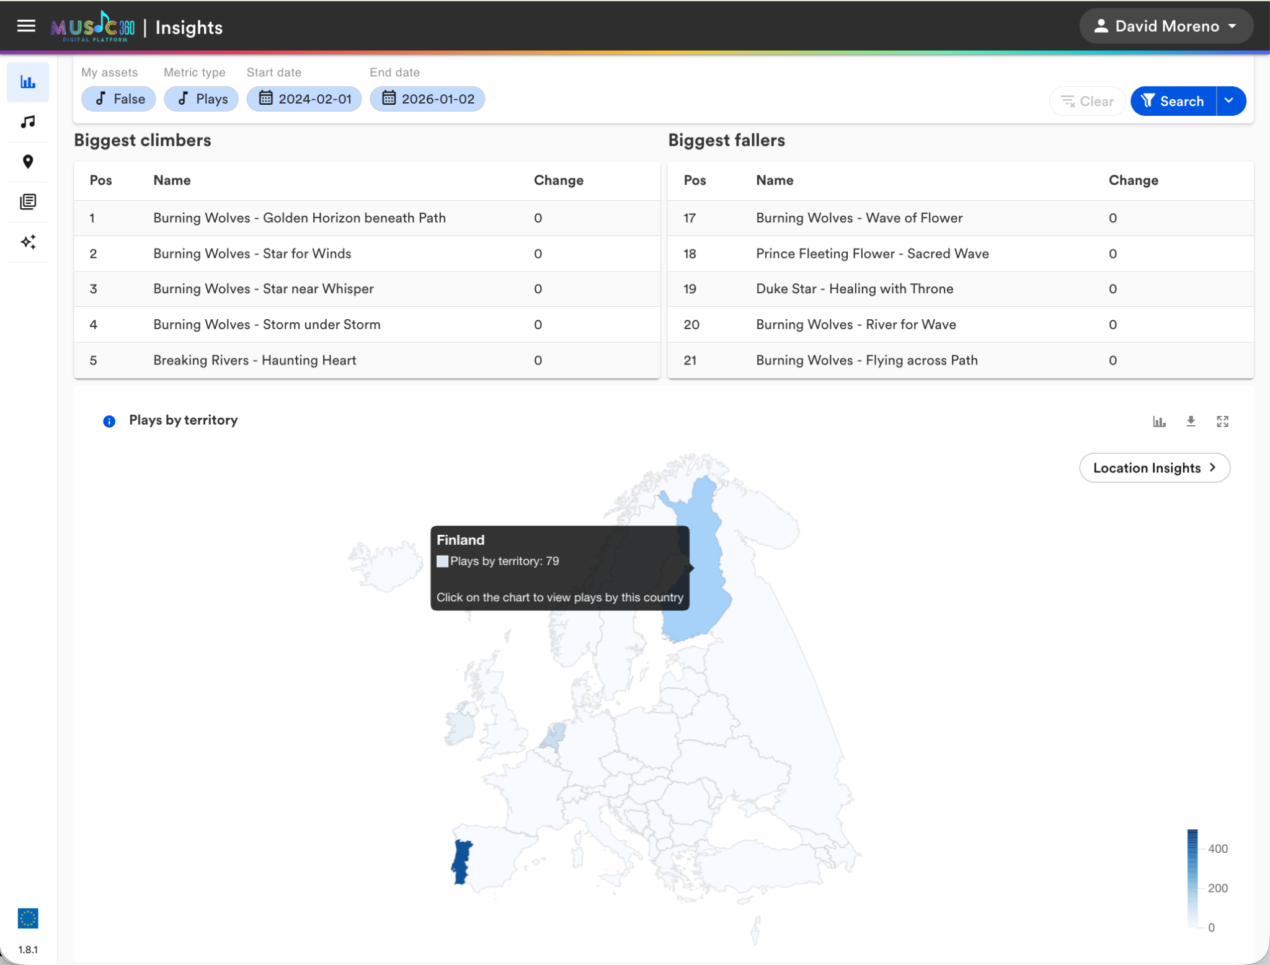
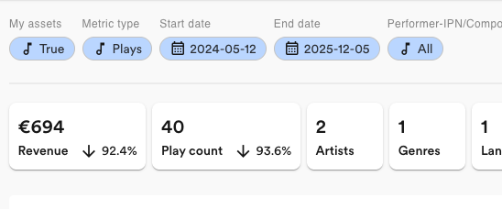
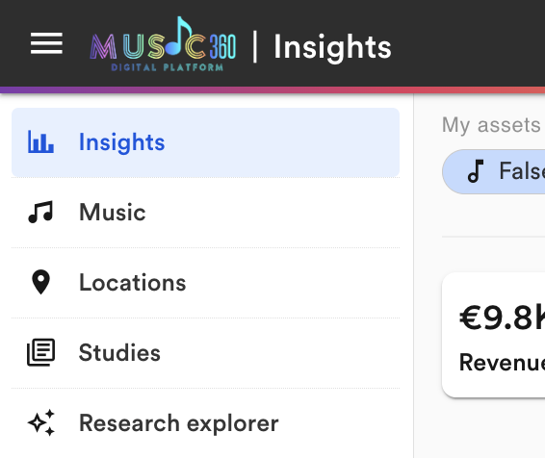
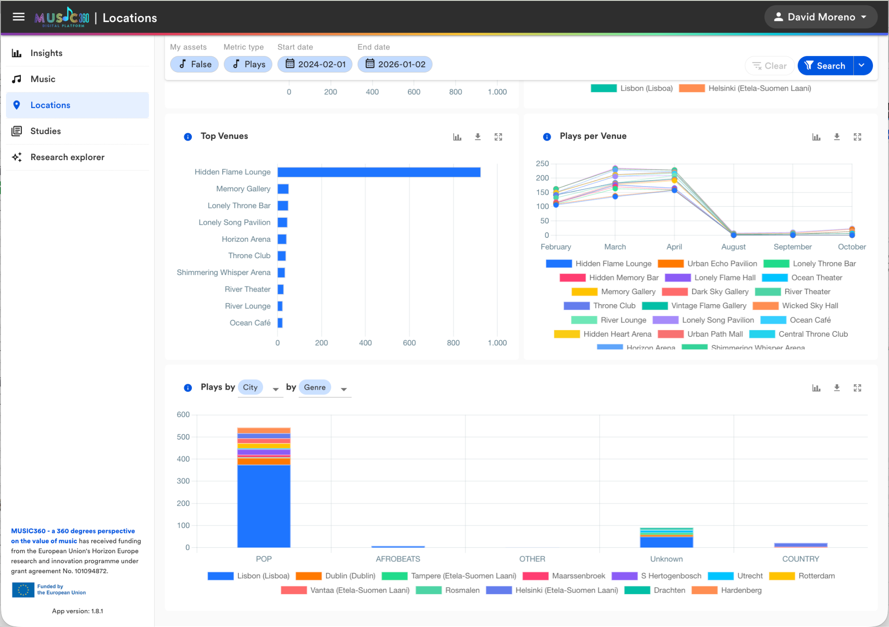
The Music360 Dashboard v2 (Quantitative Insights)
Advanced filtering of harmonized music usage (by country, city, venue type, genre, language…).
Enables creators and CMOs to see cross-border usage—often for the first time—breaking down European market fragmentation.

Slide 34
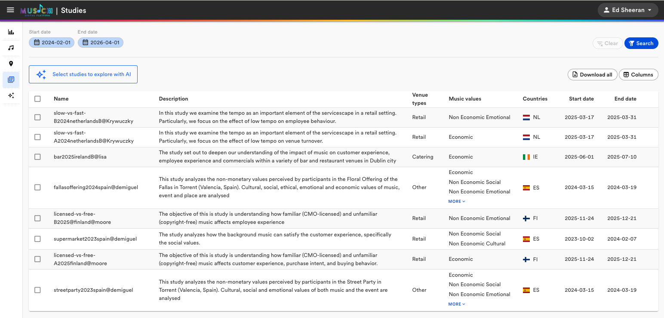
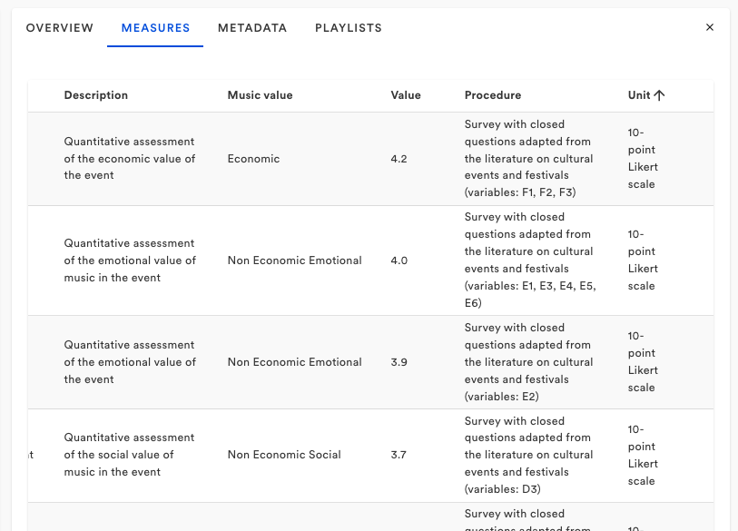
Integrating Qualitative Insights (Cultural Value)
Moving beyond pure financial tracking.
Introduction of the "Studies" module to browse the psychological and social value of music.

Slide 35
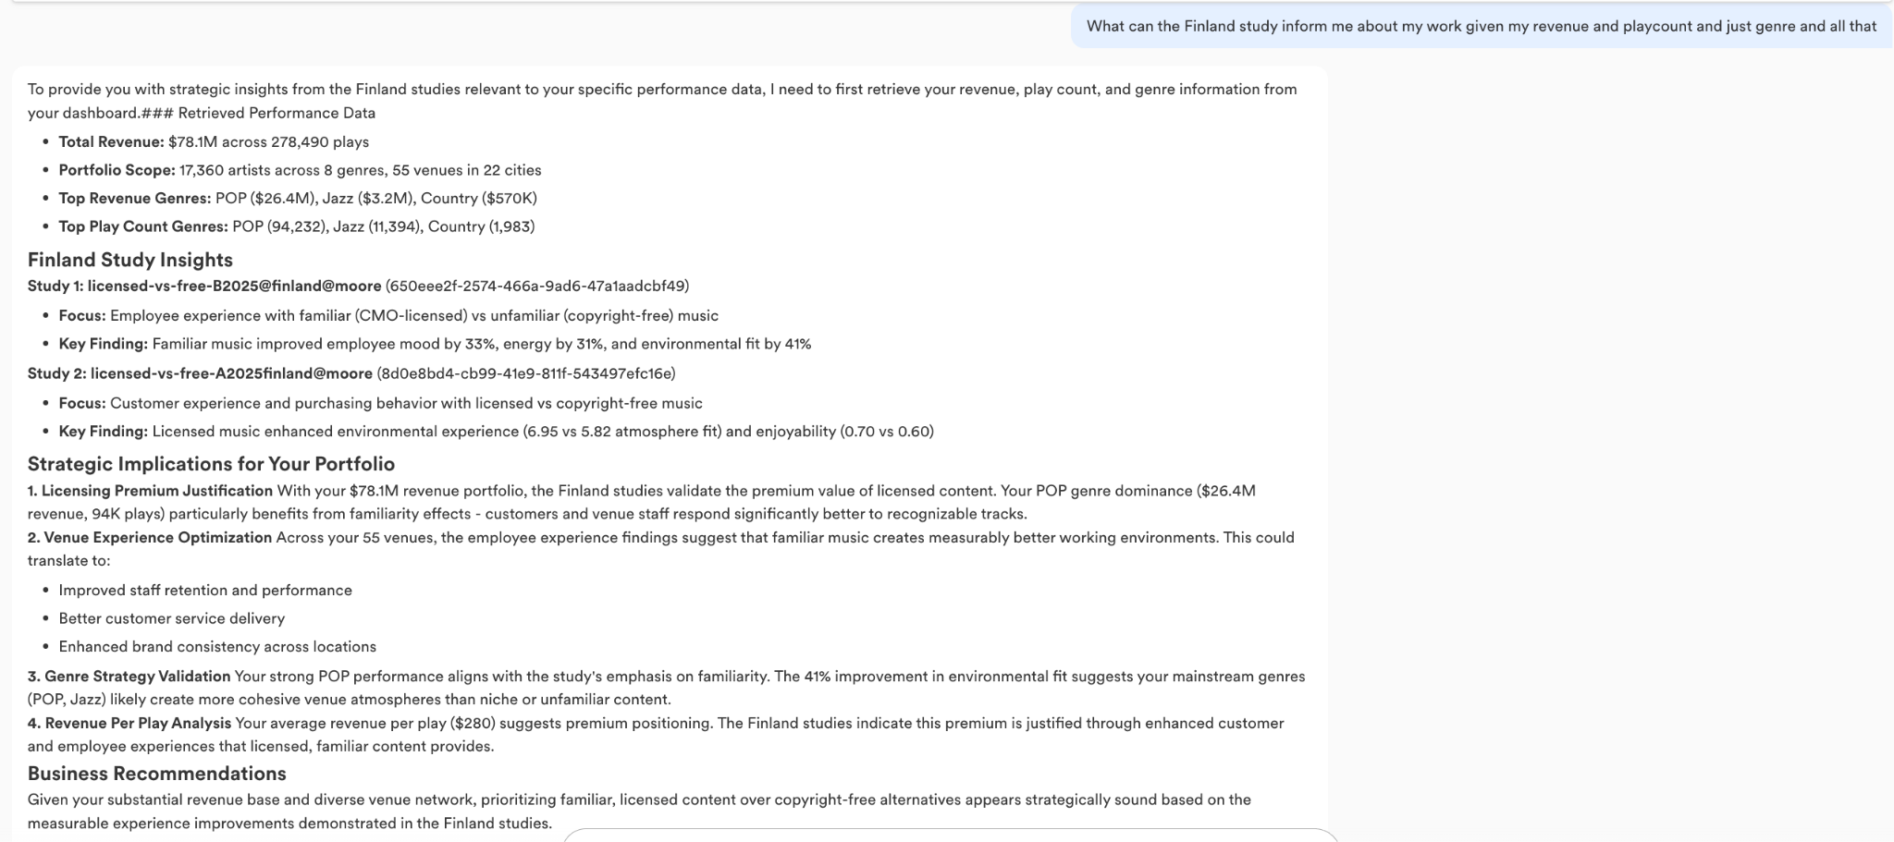
Democratizing Data: The Research Explorer Agent
A persona-aware Large Language Model (LLM) integrated directly into the dashboard.
Synthesizes both quantitative stats and qualitative study data securely.
Why it matters: Allows technical and non-technical users (policy makers, artists) to query complex cross-border datasets using Natural Language instead of SQL/complex filters, with personalized answers.

Slide 36
Results and outcomes
R8: Design of a Music360 platform for stakeholder value analysis and reporting
  Delivered a fully functional, secure, AI-enhanced, federated platform serving diverse personas.
OUT4: Better data quality
  AI-driven ingestion transformed raw local logs into standardized metadata enriched with IPI/IPN codes.
OUT7: Insight into the value of music
  Researchers have an unprecedented, GDPR-compliant API and LLM interface to study music's societal footprint.
OUT9: Insight in business opportunities
  Creators and CMOs can finally view cross-border usage of their assets, addressing EU market fragmentation and providing them with visibility and a tool to identify new business opportunities.

Slide 37
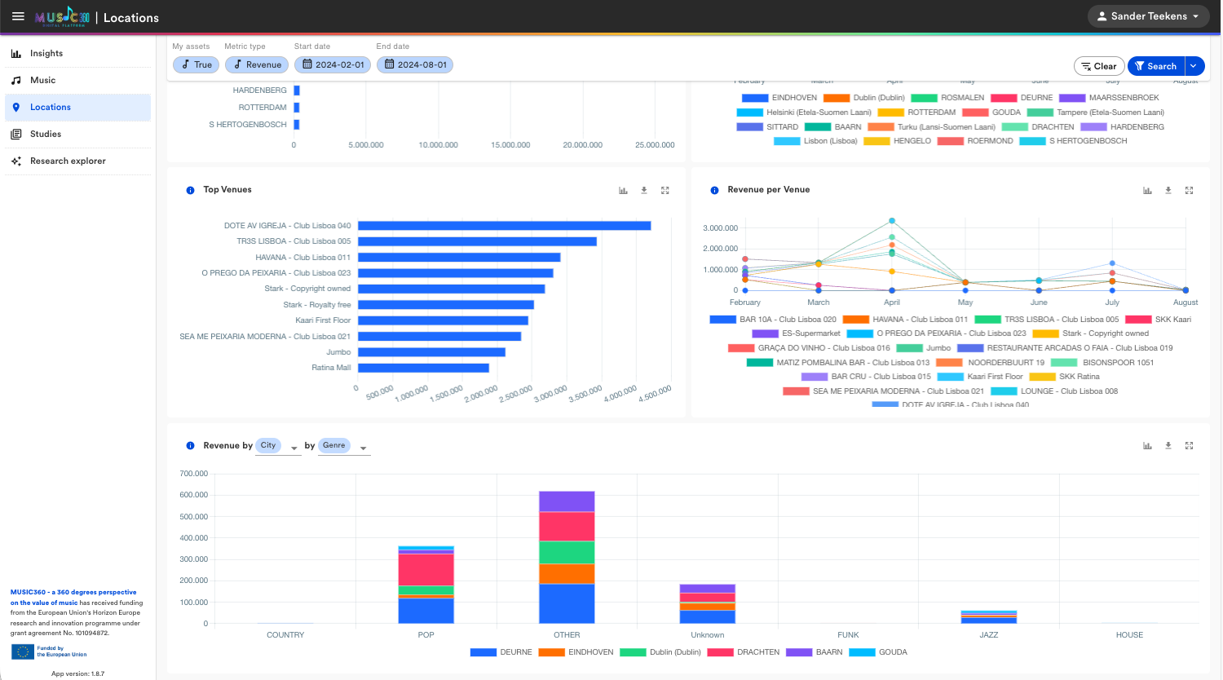
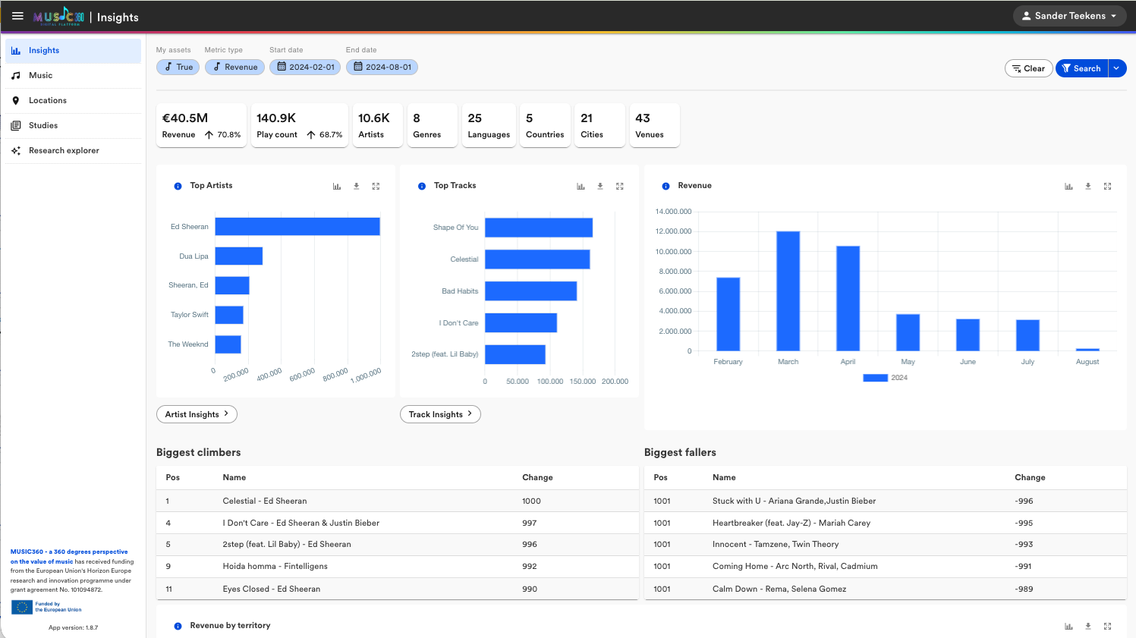
Conclusion & Future Potential
  WP3 delivered all objectives, moving from wireframes to a robust, data-rich European Data Space.
  The architecture proves that commercial confidentiality and open science can coexist.
  Sets a scalable, compliant technical foundation for future cross-border data transactions in the creative sectors (paving the way for future EU initiatives).

Slide 38
Work package 4 - Ecosystem-level reporting and analysis of music value creation, distribution and consumption
Roel Wieringa, (TVE)
Reporting to policy makers, journalists, researchers etc. requires aggregate data about the entire ecosystem that preserves anonymity.
We created a dashboard that shows aggregate value flows in the music ecosystem.
Provides important decision-support information for policymakers.
Notes:
WP1 builds the theoretical foundation for measuring the value of music in Music360. The table gives an overview of the different aspects of the project. We started from a limited set of questions, leading to different tasks to answer the questions, after which we described the different results, that finally lead to a framework for quantifying and qualifying the value of music.

Slide 39
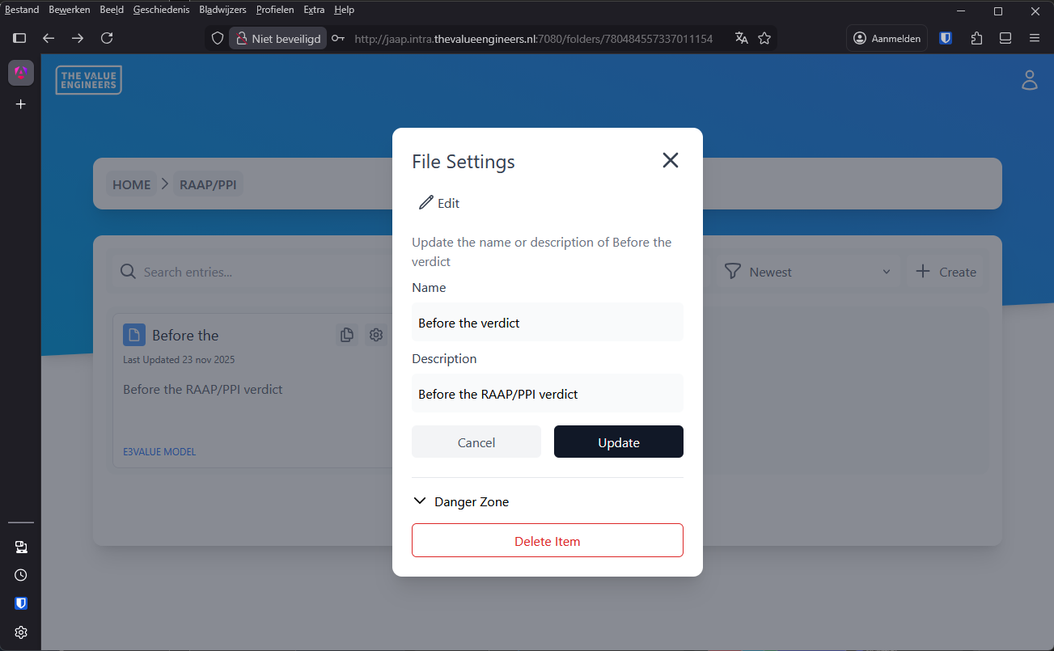
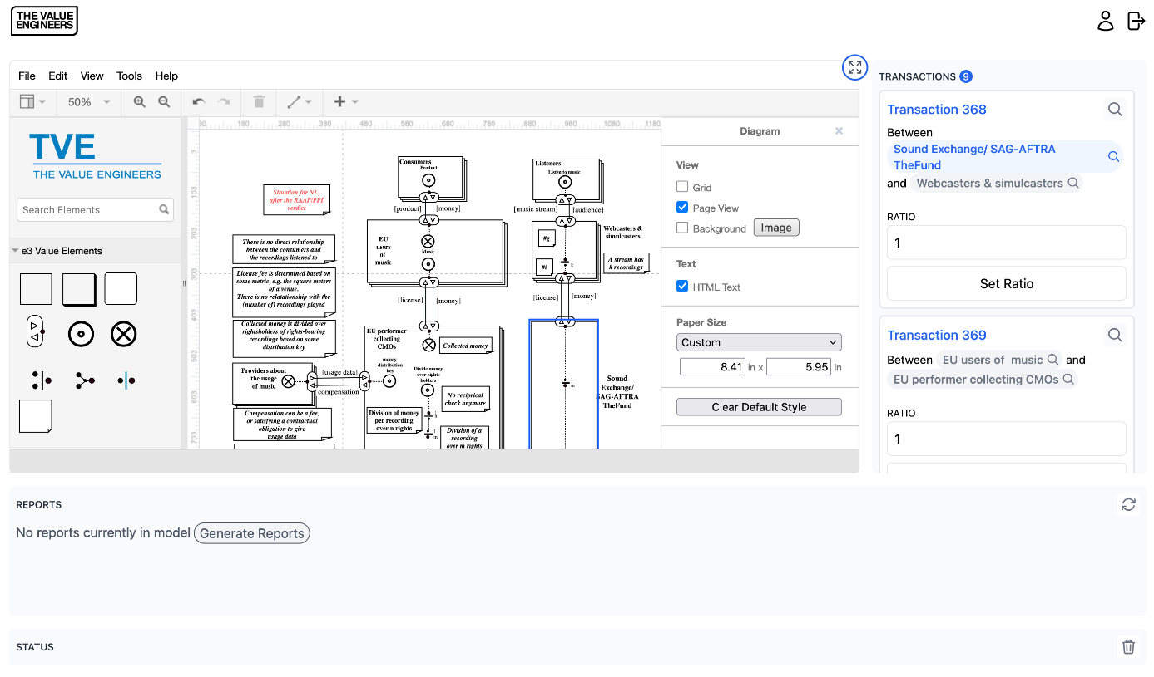
R9: Design of a Music360 platform for ecosystem value analysis and reporting
Web-enabled platform to graphically (re)design the music ecosystem
Net value analysis for quantified models
Extensible micro-service architecture
Used by many universities around the world for teaching, for example:
Hanze hogeschool, Groningen, The Netherlands, Technical University Munich, Germany, University of Malaysia, Sarawak, Malaysia, University of Gent, Belgium, University of Utrecht, The Netherlands, University of Twente, The Netherlands, Vrije Universiteit Amsterdam, The Netherlands, …

Slide 40
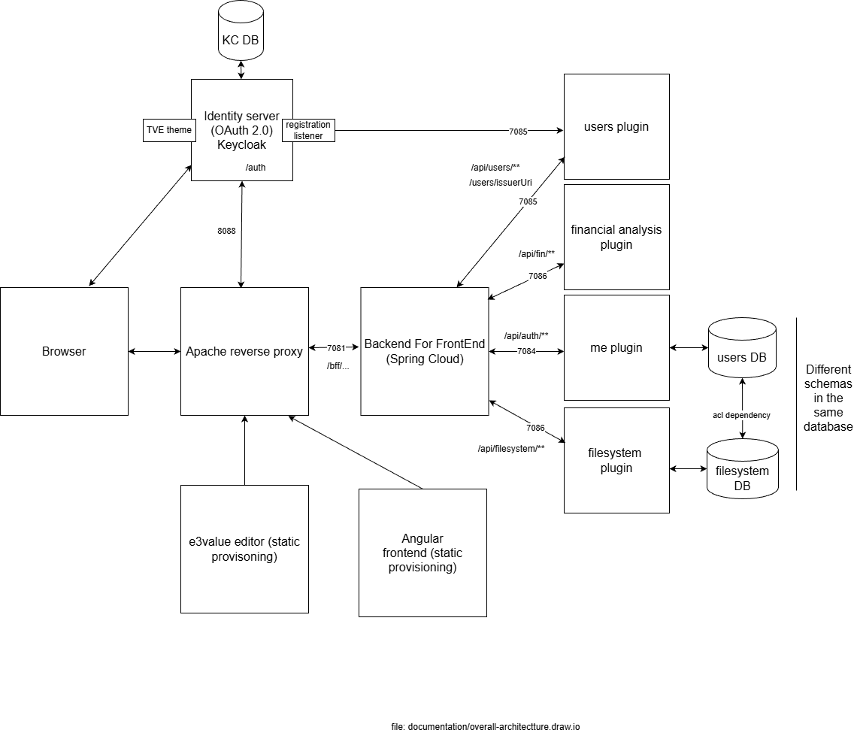
R7: Design of secure representation & access permission of confidential metadata
Integration in the Music360 architecture:
Authentication and authorization with OAuth 2.0 / OpenID Connect (same as all data access in Music360) with production-grade implementation
Protection of data at the database level, with Row Level Security (RLS) policies

Slide 41
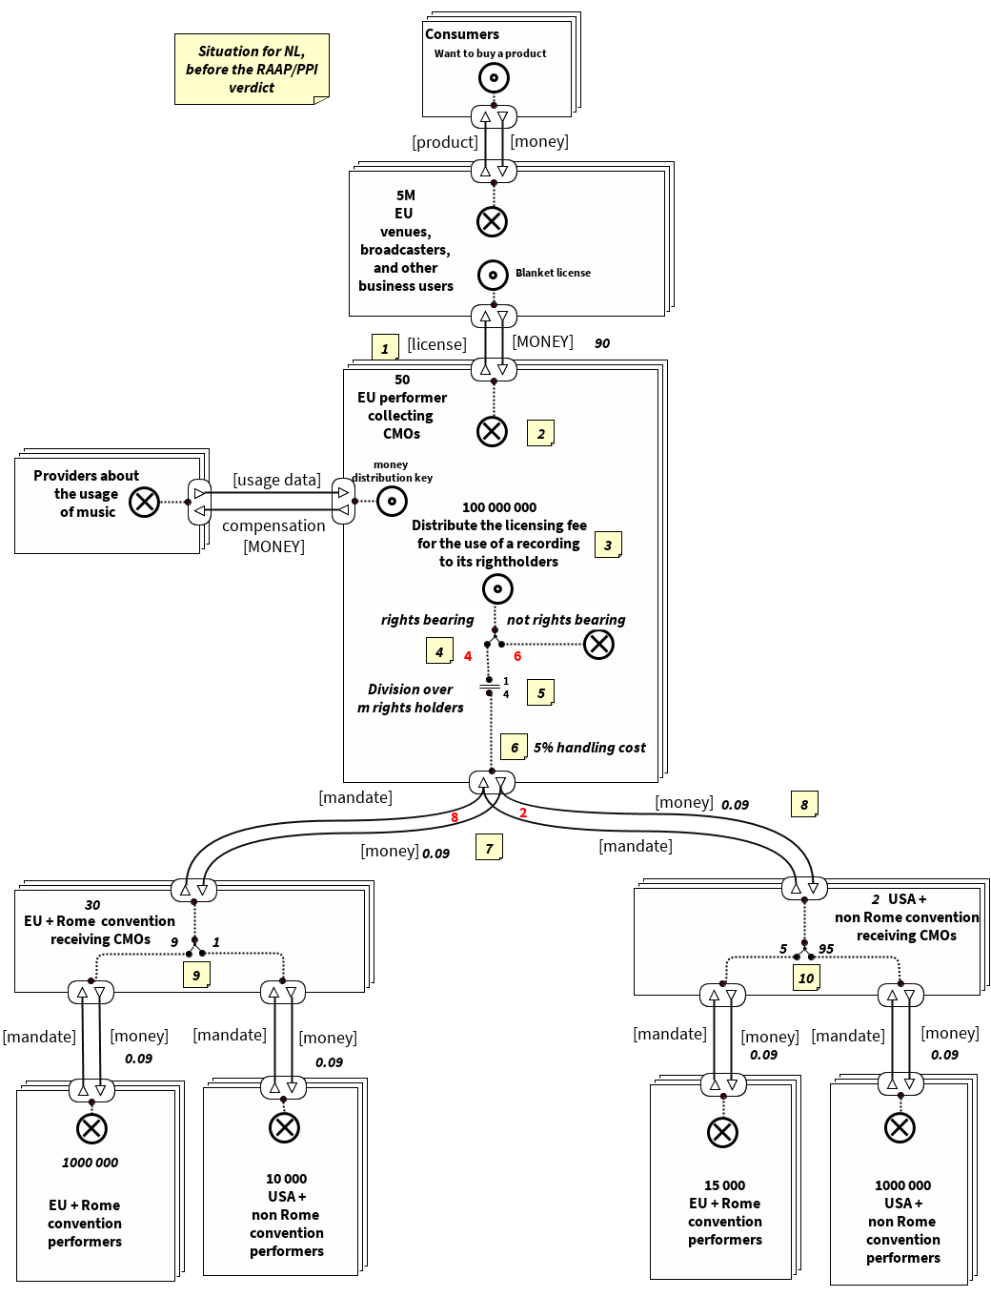
OUT11 Evidence-based decision making
Used Ecosphere to analyze the RAAP/PPI verdict:
Used data about music usage of the Dutch living lab (see also WP6)
Imported the data, with some human intervention, into the Ecosphere platform
Net value flow analysis functionality allowed to show the impact of the Court ruling for stakeholders involved (Rome vs non-Rome treaty recordings, and their rights holders).
 | Pre-verdict | Post-verdict
Rome performers | 312.075.000,00 | 130.387.500,00
Non Rome performers | 115.425.000,00 | 297.112.500,00
Note: fictitious numbers!

Slide 42
Work package 5 - Sustainable business model of Music360 solution
Bruno Gaminha (GDA)
Notes:
WP1 builds the theoretical foundation for measuring the value of music in Music360. The table gives an overview of the different aspects of the project. We started from a limited set of questions, leading to different tasks to answer the questions, after which we described the different results, that finally lead to a framework for quantifying and qualifying the value of music.

Slide 43
Work Progress
Dedicated WP5 working group led by SENA
Regular coordination on D5.1 and D5.2
Partners: TVE, VU, BMAT, BUMA, GDA, IMRO
Mapping users and value propositions
Benchmarking governance and cost models (DDEx, CISAC, SCAPR)
Notes:
Job autonomy refers to how much power and control employees have, or feel they have, in their working environment. This is an important aspect of being an employee as feeling independent and able to do their job in a way they deem fit, this increases overall job satisfaction, motivation and lower turnover (Spector, 1984).

Slide 44
Stakeholder Engagement
Broad mapping of stakeholder groups
Governance and cost model analysis
Outreach to CISAC & SCAPR
Multiple demos and feedback sessions

Slide 45
D5.1 – Business Model v1
Defines sustainable ecosystem business model for Music360 Dashboard
User mapping & value proposition analysis
Validation of business‑model scenarios
Governance & cost model evaluation for multi‑actor platform
Physical workshop

Slide 46
Deliverable D5.2 – Sustainable Business Model v2
Refinement of governance & cost models
  Adoption targets: SCAPR, CISAC, CMOs, venues, policymakers
  Governance scenarios incl. European Music Observatory
Engagement with CISAC & SCAPR
Revised & scalable business model (v2)
  Description and sustainability of Ecosystem components, such as ontology, relational data model, SMPC/HE privacy tech, Experimentation Toolkit
  Indicative technical cost: ~€1M (excl. legal & rollout)

Slide 47
Work package 6 - Living labs
Lisa Ni Choisdealbha (IMRO), Piia Moore (GTM)
Notes:
WP1 builds the theoretical foundation for measuring the value of music in Music360. The table gives an overview of the different aspects of the project. We started from a limited set of questions, leading to different tasks to answer the questions, after which we described the different results, that finally lead to a framework for quantifying and qualifying the value of music.

Slide 48
Work package 6 - Living labs
Scope & Methods
Five-country Living Labs
Spain Netherlands Finland
Ireland Portugal
Measuring a variety of impacts:
Cultural Economic Social Therapeutic
Using a variety of research tools:
Audio fingerprinting Surveys Observation Evidence-based frameworks.

Slide 49
Work package 6 - Living labs
Cross-country Insight
Music influences
Customer behavior:
Employee well-being;
Cultural identity;
Fair rights distribution;
Health outcomes
Far beyond entertainment.

Slide 50
Work package 6 - Living labs
Operational Impact
Data-driven insights guide
CMOs,
Policymakers
Healthcare
Retail
Hospitality
Optimising music’s measurable value.

Slide 51
A field validated Music360 solution
Demonstrated feasibility of in‑venue audio monitoring
Verified data pipelines (fingerprinting → rights matching → allocation)
Confirmed cross-sector applicability (retail, hospitality, culture, healthcare)
Validated Experimentation Toolkit for reproducible research
Provided evidence base for fairer, data-driven rights distribution
Fingerprinting
Audio and track detection
Repertoire Matching
VRDB
Identity Matching
IPD
CMO Allocation
ETL + Policy

Slide 52
Results and Outcomes
Stakeholder needs for understanding the value of music
Field-validated Music360 platform with stakeholders
More accurate royalty distribution
Insight into the value of music
Evidence-based decision making
Impact greater than financial/entertainment

Slide 53
Portugal — More Accurate Royalty Distribution
The Portuguese Living Lab introduced direct in‑venue audio fingerprinting across 14 venues (425,665 plays; 46,655 unique recordings).
62% of venue‑played tracks were not in traditional broadcast reference models proving currently used proxy models miss large parts of real repertoire.
However, high‑value, high‑rotation tracks do overlap, meaning the shift to usage‑based distribution corrects unfairness without destabilising payouts.
80% of venues support usage‑based remuneration, validating adoption readiness.
Outcome:
Evidence-based, hybrid royalty distribution becomes feasible, fairer, and more transparent.
Notes:
1. “The Portuguese Living Lab introduced direct in‑venue audio fingerprinting across 14 venues (425,665 plays; 46,655 unique recordings).”
The deployment of audio fingerprinting monitoring in 14 venues.
Total plays: 425,665.
Unique recordings: 46,655.
2. “62% of venue‑played tracks were not in traditional radio/TV datasets.”
This comes from the subsection comparing venue repertoire to broadcast repertoire:
28,888 of 46,655 tracks were missing from the broadcast dataset → 61.95%.
3. “Proxy models miss large parts of real repertoire.”
The report states:
Most venue-used recordings are not represented in broadcast reference models.
Venue repertoires are heterogeneous, long‑tailed, and poorly reflected in broadcast proxies.
This is explicitly noted in the comparative analysis and in the conclusion about the need to go beyond broadcast proxies.
4. “However, high‑value, high‑rotation tracks do overlap…”
The report highlights that:
While overlap between venue and broadcast datasets is small in number, the shared recordings have very high usage intensity (avg. 165.3 plays per track).
These are the “most economically relevant tracks.”
This moderates the distributional impact of missing long‑tail items.
5. “Meaning the shift to usage‑based distribution corrects unfairness without destabilising payouts.”
This conclusion is grounded in:
The finding that important high‑rotation tracks are present in both datasets.
Therefore, switching to usage-based evidence will change some allocations but not radically distort outcomes.
The report explicitly states this insight in the discussion about distribution‑impact moderation.
6. “80% of venues support usage‑based remuneration, validating adoption readiness.”
This is taken from the survey section:
Survey responses show that 80% of venues say royalties should reflect actual music played.
This is presented as a strong indicator of stakeholder acceptance.

Slide 54
Ireland - Insight Into the Value of Music (1/2)
Hospitality
Music is a core brand asset & needs to be treated as a strategic priority
It defines identity, increases dwell time, influences customer behaviour.
Drives sales, customer retention, repeat visits, and memorable experiences.
Strong, positive impact on staff energy, mood, and work pace.
Outcome
Curated and planned music, which suits the customer and style of the venue will boost revenue through increased sales and customer loyalty

Slide 55
Netherlands & Finland
Insight Into the Value of Music (1/2)
Retail
Music tempo affects employee well‑being: slow music boosts mood and job satisfaction.
Familiar (COM-licensed) music boosts employee energy and mood and fits the store’s brand better.
Customer behaviour less affected than employees, but atmosphere quality improves.
Outcome
Understanding the right type of music to suit your customers, employees and retail focus is vital to revenue, staff morale and customer spend

Slide 56
Spain - Insight Into the Value of Music (2/2)
Cultural Events
Music increases authenticity, memorability, loyalty, and supports cultural identity.
Supermarkets
Music improves employee mood and productivity, though employees dislike repetitive playlists.
Both customers and employees link music to memories, atmosphere, and social value.
Outcome:
Music generates measurable value across sectors — commercial, emotional, cultural, and organisational.

Slide 57
Evidence‑Based Decision Making
MUSIC360 delivers empirical, real‑world evidence of policy changes :
Data-driven rights allocation.
Sector‑specific music strategy (retail, hospitality, culture, healthcare).
Transparent policy evaluation (e.g., RAAP/PPI case)
Shows that employees are the most musically sensitive group — an insight valuable for management.
Outcome:
Robust, reproducible data infrastructure supports smarter licensing decisions, policy design, and organisational music strategy.
Notes:
Music360 enables clear, evidence-based assessment of policy changes:
RAAP/PPI case modeled using e3 value approach (Living Lab evidence)
Model reproduced real CMO distribution results with <1% deviation
Allows simulation of ‘before vs after’ money flows under new legal rules
Stakeholders can see exactly who gains/loses from policy changes
Improves trust and clarity in royalty governance

Slide 58
Spain – “Left of field” Musical Application
Medical - (Oncology Unit) investigated two types of music‑based interventions for cancer patients:
1. Guided relaxation sessions using recorded music
2. Live mini‑concerts performed in the treatment area
Both interventions were tested using pre‑ and post‑session Edmonton Symptom Assessment System (ESAS) measurements.
Both music interventions improved psychological and physiological symptoms (tiredness, anxiety, etc)
The two approaches worked through different therapeutic mechanisms:
- Relaxation music → calming, stabilizing, reduces stress and fatigue
- Live mini‑concerts → energizing, uplifting, more socially engaging

Slide 59
Benefits appeared consistently across patient groups (e.g., lung, breast, colon, lymphoma), confirming broad applicability.
Outcome Interpretation
While the study did not literally measure days spent in hospital, the improvement in symptoms that typically extend hospital stays (fatigue, anxiety, nausea, pain) strongly supports the idea that music interventions can contribute to:
Shorter overall recovery times
Less symptom burden during treatment
Lower stress and improved clinical experience
This supports the Music360 objective that evidence-based music interventions can help reduce hospital burden and enhance patient well-being.

Slide 60
Work package 7 - Dissemination, communication and exploitation
Notes:
WP1 builds the theoretical foundation for measuring the value of music in Music360. The table gives an overview of the different aspects of the project. We started from a limited set of questions, leading to different tasks to answer the questions, after which we described the different results, that finally lead to a framework for quantifying and qualifying the value of music.

Slide 61
Work package 7
Dissemination, communication and exploitation
Music360 WP7 - Final Report Highlights
Project Purpose
WP7 Objectives
Key Findings
KPI Performance
Dissemination Activities
Long Term Effects
Exploitation & Policy Follow up
Conclusion

Slide 62
Music360 WP7 – Final Report Highlights
Strategic Communication Alignment
  Music360 ensured clear, consistent communication bridging technical outputs with stakeholder needs across all channels.
Measurable Dissemination Success
  The project achieved significant progress in dissemination reach, publications, and engagement at industry events and conferences.
Evidence-Based Impact Narrative
  Music360 demonstrated how background music generates measurable economic, cultural, and social value across Europe.
KPI Adjustment Collaboration
  Collaboration with the European Commission refined communication KPI’s to better reflect actual dissemination behavior.

Slide 63
Project Purpose
Addressing Structural Issues
  Music360 resolves transparency and evidence gaps in Europe's music ecosystem for better value understanding.
360-degree Evidence Framework
  The platform integrates fingerprinting, usage metrics, and metadata to guide remuneration and policy.
Broader Societal Impact
  Music360 shows how music shapes consumer behavior, wellbeing, brand identity across various sectors.
Music360’s Communication Role
  Music360 ensures clear, targeted communication translating complex insights for diverse stakeholders.

Slide 64
Objectives
Strategic Dissemination Coordination
  Music360 coordinated dissemination planning and maintained the project website to ensure wide and effective communication.
Industry and Academic Engagement
  Music360 engaged with music industry events and major sector organizations to align stakeholders and extend project reach.
Adaptive Communication Metrics
  Music360 shifted from follower-based KPIs to impression-based metrics and adopted LinkedIn-first approach for better impact.
Long-Term Impact and Exploitation
  Music360 focused on ensuring long-term exploitation by evolving communication practices and supporting policy-relevant insights.

Slide 65
KPI Performance
Recalibrated KPI Metrics
  KPIs were adjusted to track social media and website impressions, improving accuracy in digital communication reporting.
Strong Dissemination Outcomes
  Music360 exceeded targets with over 70,000 LinkedIn impressions and 14,275 website views, reflecting wide public engagement.
Robust Event and Media Presence
  32 events, 7 demos, 12 press releases, and multiple radio and TV appearances highlight active stakeholder engagement.
Scientific Output Growth
  The project logged 44 publications including 33 peer-reviewed papers, showing strong academic and industry impact.

Slide 66
Dissemination Activities
Diverse Dissemination Channels
  Music360 utilized 69 actions across multiple countries and sectors for broad and resilient outreach.
Notable Events Participation
  Engagement in key events like Eurosonic Noorderslag, Berklee presentations, and major scientific conferences.
Media and Public Engagement
  Strong press coverage in Finland and Spain with Living Lab findings sparking broad media discussions.
Strategic Digital Communication
  Effective use of LinkedIn, newsletters, partner channels, and policy briefs for cross-audience visibility.

Slide 67
Long Term Effects
Methodological Framework
  Developed a validated framework measuring economic, social, and cultural value of music in real settings.
Living Lab Approach
  Implemented adaptable Living Labs in multiple countries to enable reproducible cross-sector research and experimentation.
Stakeholder Alignment
  Strengthened partnerships among CMOs, venues, policymakers, researchers, and industry for shared data-driven music valuation.
Sustainability and Future Impact
  Established a strong evidence base and framework for ongoing dialogue, policy reflection, and integration into EU initiatives.

Slide 68
Exploitation & Policy Follow up
Sustainability and Policy Pathways
  Music360 created sustainable pathways by translating research into actionable insights for policymakers and industry actors.
Proposed Follow-Up Actions
  Key proposals include a music subsection in EU Cultural Data Hub, stakeholder group for decentralized platform, and policy recognition of music’s value.
Exploitation Steering Group
  A steering group coordinates future opportunities, policy engagement, and integration with emerging EU digital initiatives.
Ethical Compliance and Governance
  Emphasizes sustainability and compliance, ensuring ethical, legal, and GDPR-aligned exploitation activities.

Slide 69
Conclusion
Successful Project Delivery
  Music360 effectively met its objectives by enabling communication, dissemination, and exploitation of project results.
Strategic Adaptability
  Music360 adapted strategies to real-world dynamics by focusing on LinkedIn, stakeholder engagement, and industry events.
Academic and Methodological Impact
  The project advanced academic knowledge with interdisciplinary publications and innovative analytical methods.
Legacy and Future Collaboration
  Music360 established a strong evidence base, validated methods, and partnerships supporting future policy and research.

Slide 70
Work package 8 - Project management and data management
Lima Kohestani (VU)
Notes:
WP1 builds the theoretical foundation for measuring the value of music in Music360. The table gives an overview of the different aspects of the project. We started from a limited set of questions, leading to different tasks to answer the questions, after which we described the different results, that finally lead to a framework for quantifying and qualifying the value of music.

Slide 71
Work package 8 - Resources
 | WP1 | WP2 | WP3 | WP4 | WP5 | WP6 | WP7 | WP8
realized | 45,11 | 75,42 | 41,73286 | 59,15 | 13,91904 | 112,5411 | 28,08804 | 28,50321
planned | 56 | 73 | 44 | 35 | 14 | 119 | 25 | 23
Notes:
WP1 builds the theoretical foundation for measuring the value of music in Music360. The table gives an overview of the different aspects of the project. We started from a limited set of questions, leading to different tasks to answer the questions, after which we described the different results, that finally lead to a framework for quantifying and qualifying the value of music.

Slide 72
Work package 9 – Ethics
María de Miguel Molina (UPV)
Notes:
WP1 builds the theoretical foundation for measuring the value of music in Music360. The table gives an overview of the different aspects of the project. We started from a limited set of questions, leading to different tasks to answer the questions, after which we described the different results, that finally lead to a framework for quantifying and qualifying the value of music.

Slide 73
Deliverables 9.1, 9.2 & 9.3 – Participants/Personal Data Protection (reviewed)
  Inform the participants in the Living Labs and manage consent for collecting/processing personal data.
  Limit access to the personal/sensitive data to only authorised researchers and protect the data with relevant IT security technologies (anonymization and pseudo-anonymization).
  Consider bias reduction both in the collection and analysis of data.

Slide 74
Deliverable 9.4 – Ethics External Board
They have provided recommendations for:
  Controlling a privacy by design.
  Monitoring a security by design.
Prof. Marieke L. Fransen: experience in human-centred approach.
Mr. José Manuel López: experience in proactive risk-based approach.
Mr. Christos Bellos: experience transparency and quality approach.

Slide 75
WP9 Ethics
Object: personal data protection of the respondents of Music360 Living Labs.
Objective: to ensure compliance recommending the legal and ethics requirements for protecting personal data.
Seven deliverables: four by the consortium and three with the External Ethics Board.

Slide 76
Deliverables 9.1, 9.2 & 9.3 – Participants/Personal Data Protection (reviewed after Board reports)
  Inform the participants in the Living Labs and manage consent for collecting/processing personal data.
  Limit access to the personal/sensitive data to only authorised researchers and protect the data with relevant IT security technologies (anonymization and pseudo-anonymization).
  Consider bias reduction both in the collection and analysis of data.

Slide 77
Deliverable 9.4 – Ethics External Board
They have provided recommendations for:
  Controlling a privacy by design.
  Monitoring a security by design.
Prof. Marieke L. Fransen: experience in human-centred approach.
Mr. José Manuel López: experience in proactive risk-based approach.
Mr. Christos Bellos: experience transparency and quality approach.

Slide 78
Deliverables 9.5, 9.6 & 9.7 –Reports by the External Ethics Board
Recommendations from the experts:
  First & second reports: used to review some deliverables. They centred on manage consent with the venues, a better information to the participants depending on the living lab, processing of data, exchange of data and storing security measures, make the information accessible to the participants and provide DPO information depending on the venue.
  Third report: focused on the hospital living lab due to its relevance. Approvals from the UPV and the hospital Ethics Committees were highlighted. Explain the recruitment process (followed by the Hospital) and which information was accessed by UPV research team (anonymized results that the patients filled in in no-digital paper sheets; the information from the patients was retained by the hospital).

Slide 79
In sum: Impact
Societal impact
  Transparency of music use to musicians
  Better understanding of societal value (e.g. festivals)
  Better understanding of therapeutical value
Technological impact
  Fully decentralized architecture to harvest music usage and revenue fine-grained data
  Presentation of data in a rich way to stakeholders
  Ecosystem-level analysis tooling of the music ecosystem
Scientific impact
  Theory of value of music and experimental results, ontology of music, validated use & design of SMPC/HE applications
Economic impact
  Better understanding of the economic value of music for retail and hospitality (customers and employees)
  More precise allocation of collected fees to rightsholders

